Slide 1
Research Project Presentation
A Comparative Study of Quantum Logic Gates Suited For Current Algorithms
Aarav Ratra (21122002)
B.Tech Engineering Physics, IIT Roorkee
Supervisor: Dr. Ajay, Dept. of Physics

Slide 2
Roadmap
Review of Basic Definition of a Qubit
Review of Quantum Harmonic Oscillator, Mapping to LC Oscillator
Anharmonicity and Josephson Junction Oscillator Review, Transmon Qubit Construction
Bloch Sphere Representation of Qubit, Classical Logic Gates
Single-Qubit Quantum Gates as Rotations on Bloch Sphere
Multi-Qubit Gates Review
Simulation of Gate Action via MATLAB
Simulation of Energy Levels of Harmonic and Anharmonic Oscillator via MATLAB
Universal Sets of Gates, followed by some simulations in MATLAB

Slide 3
What is a Qubit?

Slide 4
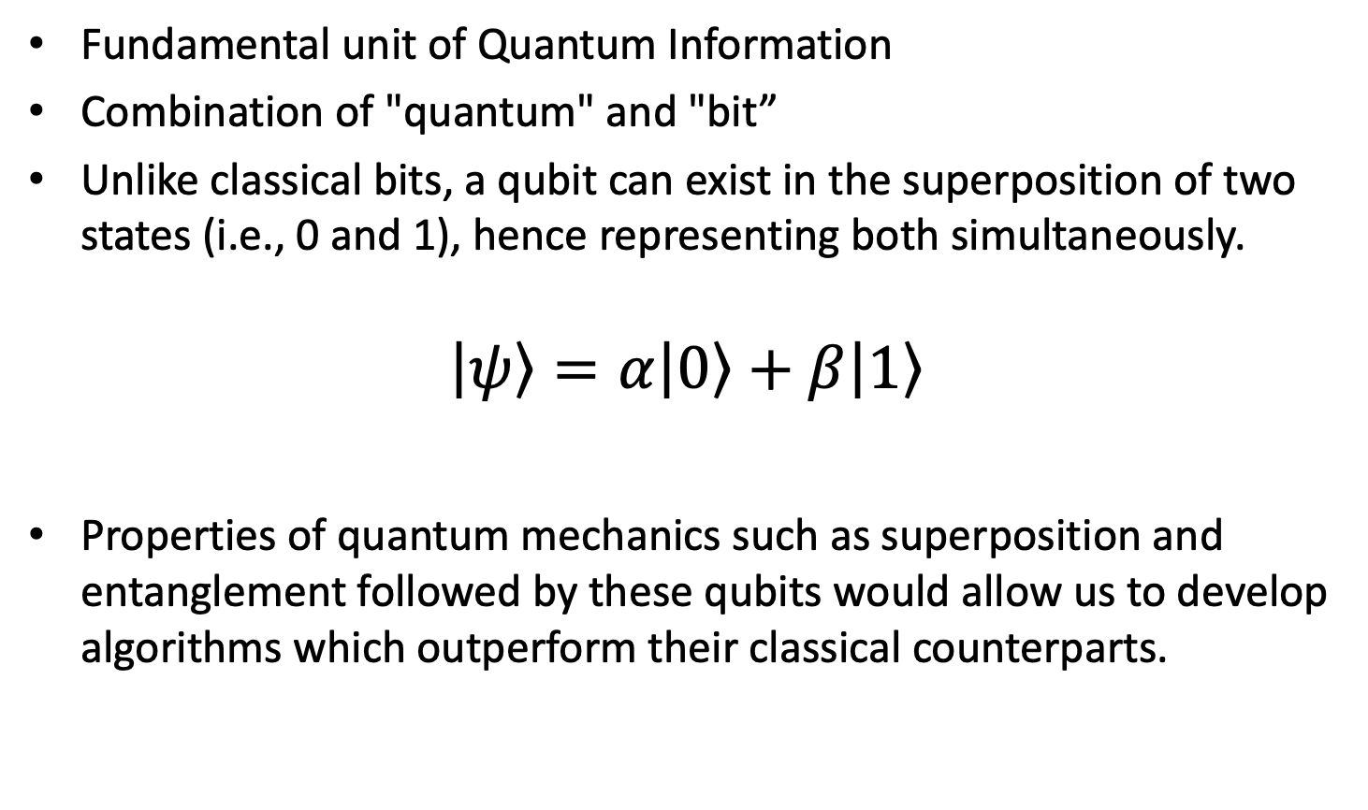
Definition of a Qubit
Fundamental unit of Quantum Information
Combination of "quantum" and "bit”
Unlike classical bits, a qubit can exist in the superposition of two states (i.e., 0 and 1), hence representing both simultaneously.
$$\left|\left.ψ\right\rangle \right.=α\left|\left.0\right\rangle \right.+β\left|\left.1\right\rangle \right.$$
Properties of quantum mechanics such as superposition and entanglement followed by these qubits would allow us to develop algorithms which outperform their classical counterparts.

Slide 5
How are Qubits implemented?
Any Two-Level Quantum System
We can implement Qubits by isolating two levels from a Multi-Level Quantum System
This leads to multiple implementations such as:
Photonic Qubits
Single Atom Qubits
Ion Trap Qubits
Superconducting Qubits
Spintronic Qubits
NV Centre Qubits

Slide 6
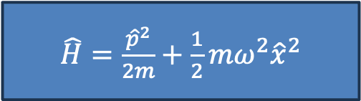
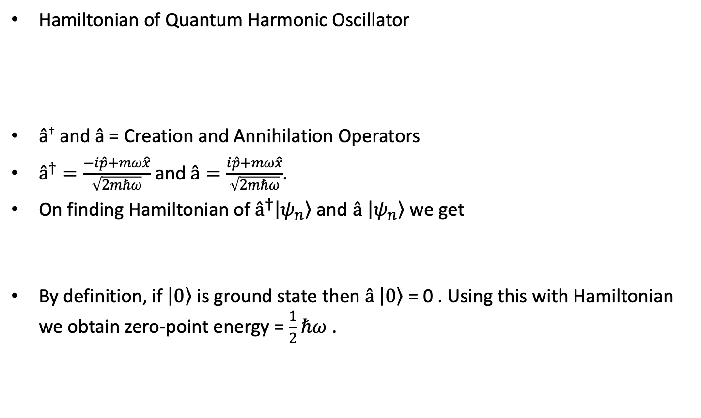
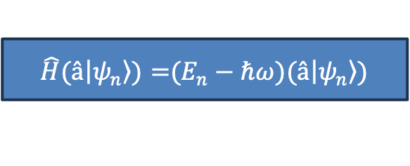
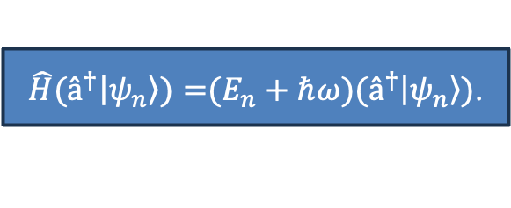

Review – Quantum Harmonic Oscillator
Hamiltonian of Quantum Harmonic Oscillator
â† and â = Creation and Annihilation Operators
$â^{†}=\frac{−i\hat{p}+mω\hat{x}}{\sqrt{2mℏω}}$ and $â=\frac{i\hat{p}+mω\hat{x}}{\sqrt{2mℏω}}$.
On finding Hamiltonian of $â^{†}\left|\left.ψ_{n}\right\rangle \right.$ and $â \left|\left.ψ_{n}\right\rangle \right.$ we get
By definition, if $\left|\left.0\right\rangle \right.$ is ground state then $â \left|\left.0\right\rangle \right.$ = 0 . Using this with Hamiltonian we obtain zero-point energy = $\frac{1}{2}ℏω$ .
$\hat{H}=\frac{{\hat{p}}^{2}}{2m}+\frac{1}{2}mω^{2}{\hat{x}}^{2}$
$$\hat{H}=ℏω\left[â^{†}â+\frac{1}{2}\right]$$
$\hat{H}(â^{†}\left|\left.ψ_{n}\right\rangle )=\right.(E_{n}+ℏω)(â^{†}\left|\left.ψ_{n}\right\rangle \right.)$.
$\hat{H}(â\left|\left.ψ_{n}\right\rangle )=\right.(E_{n}−ℏω)(â\left|\left.ψ_{n}\right\rangle \right.)$
[2] Principles of Quantum Mechanics Tyagi, S. Tyagi, I.S. 9789332517721 2012 Dorling Kindersley (India)

Slide 7
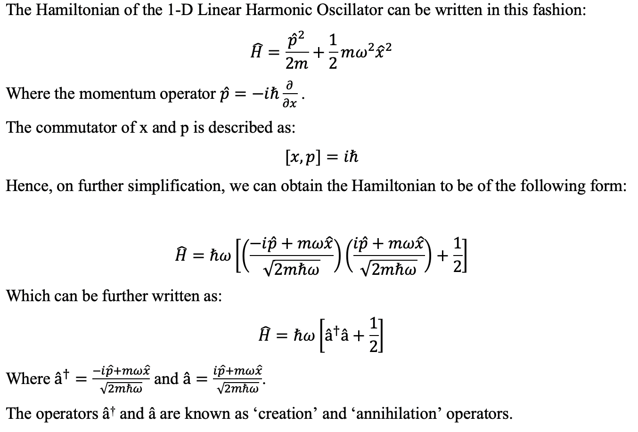
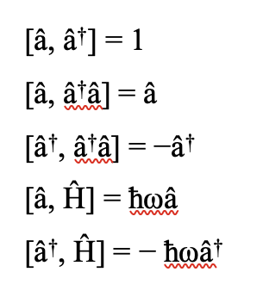
Review – Quantum Harmonic Oscillator
[2] Principles of Quantum Mechanics Tyagi, S. Tyagi, I.S. 9789332517721 2012 Dorling Kindersley (India)

Slide 8
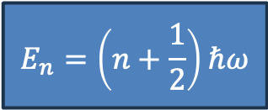
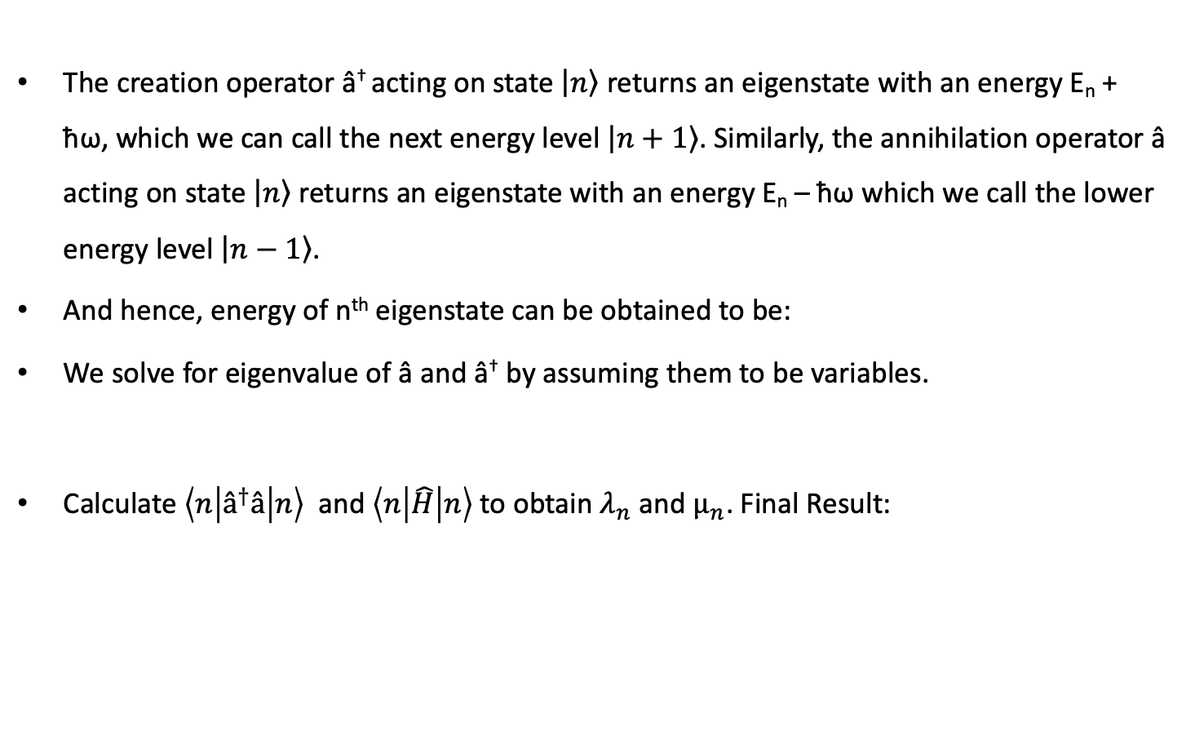
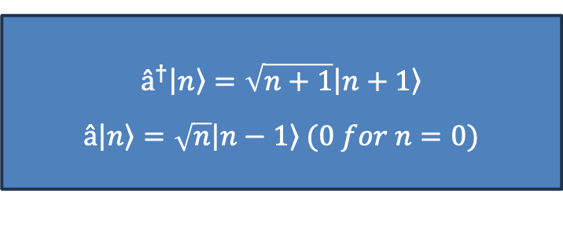

Review – Quantum Harmonic Oscillator
The creation operator â† acting on state $\left|\left.n\right\rangle \right.$ returns an eigenstate with an energy E_{n} + ħω, which we can call the next energy level $\left|\left.n+1\right\rangle \right.$. Similarly, the annihilation operator â acting on state $\left|\left.n\right\rangle \right.$ returns an eigenstate with an energy E_{n} – ħω which we call the lower energy level $\left|\left.n−1\right\rangle \right.$.
And hence, energy of n^{th} eigenstate can be obtained to be:
We solve for eigenvalue of â and â† by assuming them to be variables.
Calculate $\left\langle n | â^{†}â | n\right\rangle$ and $\left\langle n | \hat{H} | n\right\rangle$ to obtain $λ_{n}$ and $µ_{n}$. Final Result:
$$E_{n}=\left(n+\frac{1}{2}\right)ℏω$$
$$â^{†}\left|\left.n\right\rangle \right.= λ_{n}\left|\left.n+1\right\rangle \right. , â\left|\left.n\right\rangle \right.=µ_{n}\left|\left.n−1\right\rangle \right. (0 for n=0)$$
$$â^{†}\left|\left.n\right\rangle \right.=\sqrt{n+1}\left|\left.n+1\right\rangle \right.$$
$$â\left|\left.n\right\rangle \right.=\sqrt{n}\left|\left.n−1\right\rangle \right. (0 for n=0)$$
[2] Principles of Quantum Mechanics Tyagi, S. Tyagi, I.S. 9789332517721 2012 Dorling Kindersley (India)

Slide 9
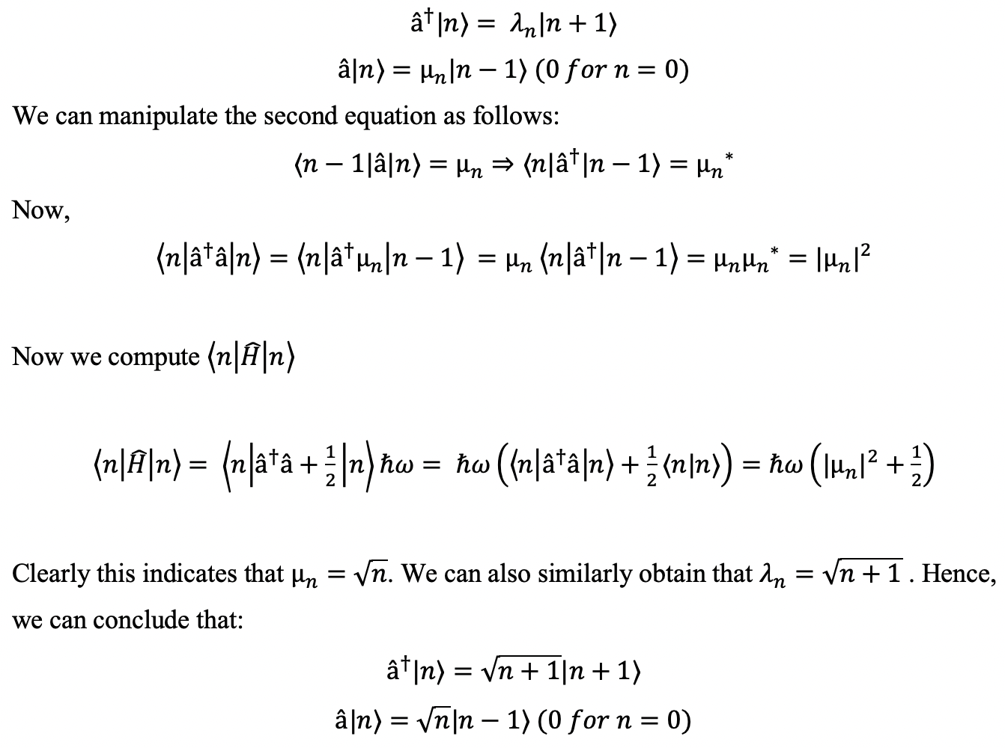
Review – Quantum Harmonic Oscillator
[2] Principles of Quantum Mechanics Tyagi, S. Tyagi, I.S. 9789332517721 2012 Dorling Kindersley (India)

Slide 10
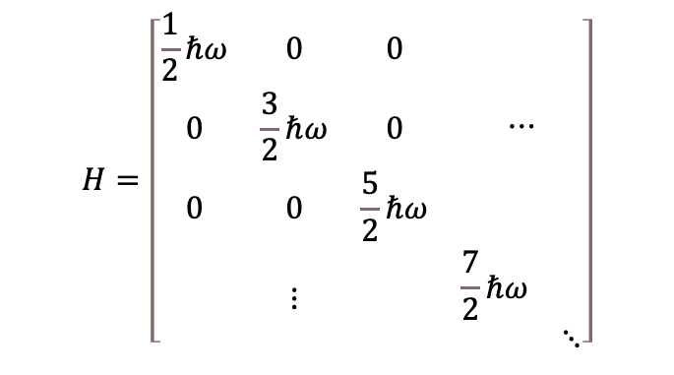
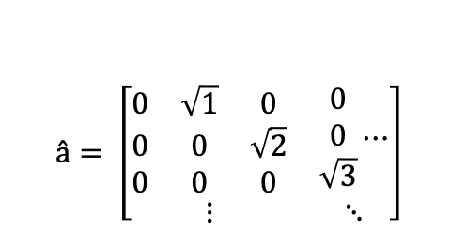
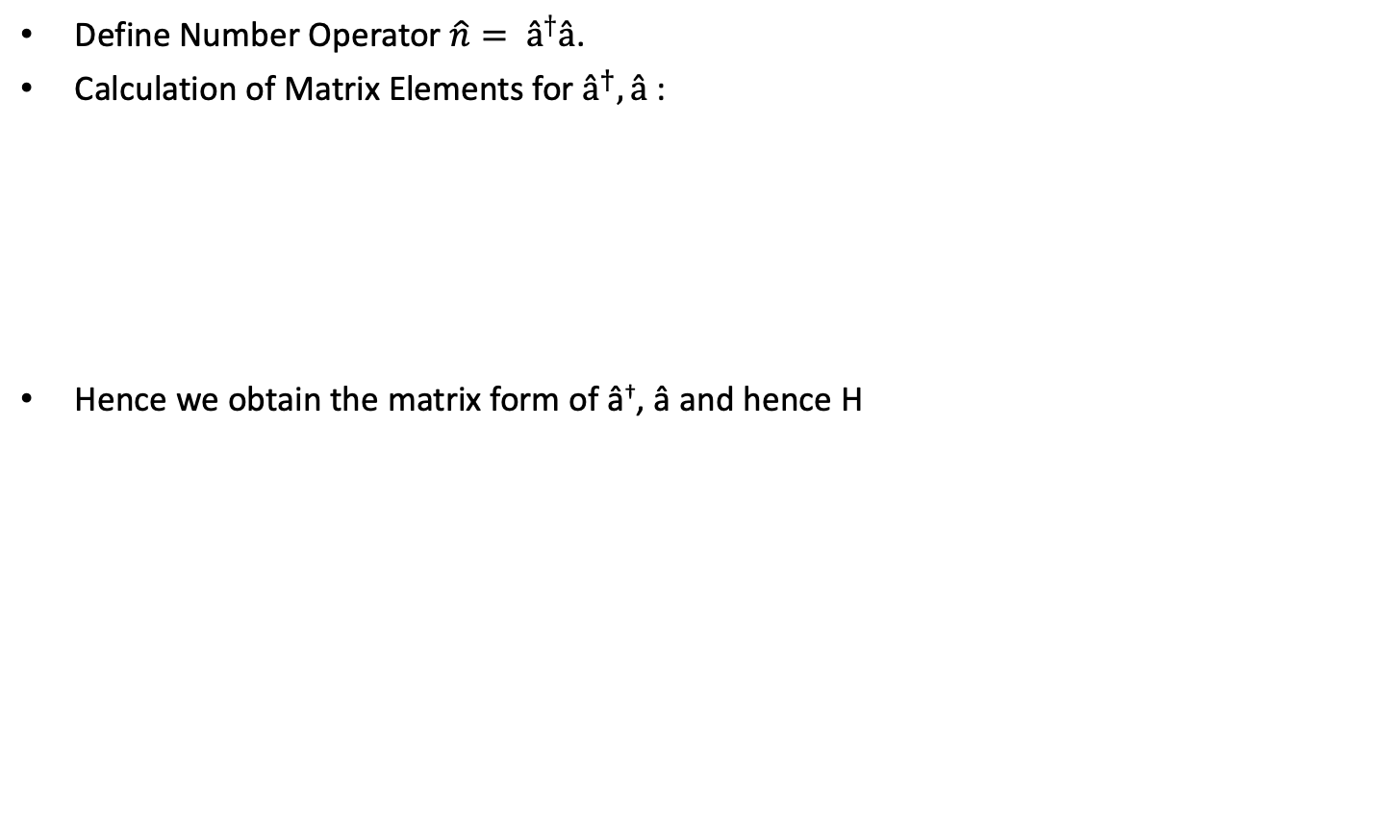
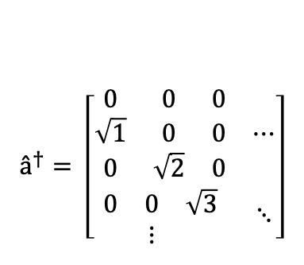
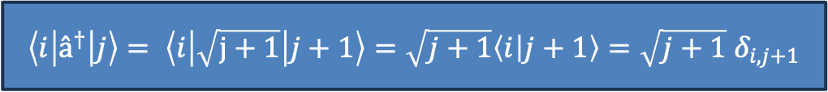
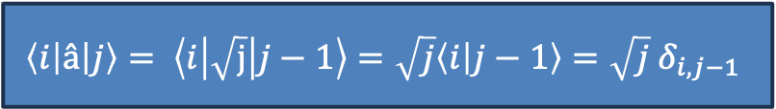
Review – Quantum Harmonic Oscillator
Define Number Operator $\hat{n}= â^{†}â$.
Calculation of Matrix Elements for $â^{†}, â$ :
Hence we obtain the matrix form of â†, â and hence H
$$\left\langle i | â | j\right\rangle = \left\langle i | \sqrt{j} | j−1\right\rangle =\sqrt{j}\left\langle i | j−1\right\rangle =\sqrt{j}{ δ}_{i,j−1}$$
$$\left\langle i | â^{†} | j\right\rangle = \left\langle i | \sqrt{j+1} | j+1\right\rangle =\sqrt{j+1}\left\langle i | j+1\right\rangle =\sqrt{j+1}{ δ}_{i,j+1}$$
$â^{†}= \left[\begin{matrix}\begin{matrix}0 & 0 & 0 \\ \sqrt{1} & 0 & 0 \\ 0 & \sqrt{2} & 0\end{matrix} & ⋯ \\ \begin{matrix}0 & 0 & \sqrt{3} \\ & ⋮ & \end{matrix} & ⋱\end{matrix}\right]$
$â= \left[\begin{matrix}\begin{matrix}0 & \sqrt{1} & 0 \\ 0 & 0 & \sqrt{2} \\ 0 & 0 & 0\end{matrix} & \begin{matrix}0 \\ 0 \\ \sqrt{3}\end{matrix}⋯ \\ ⋮ & ⋱\end{matrix}\right]$
$$H=\left[\begin{matrix}\begin{matrix}\frac{1}{2}ℏω & 0 & 0 \\ 0 & \frac{3}{2}ℏω & 0 \\ 0 & 0 & \frac{5}{2}ℏω\end{matrix} & ⋯ \\ ⋮ & \begin{matrix}\frac{7}{2}ℏω & \\ & ⋱\end{matrix}\end{matrix}\right]$$
[2] Principles of Quantum Mechanics Tyagi, S. Tyagi, I.S. 9789332517721 2012 Dorling Kindersley (India)

Slide 11
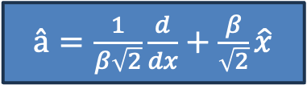

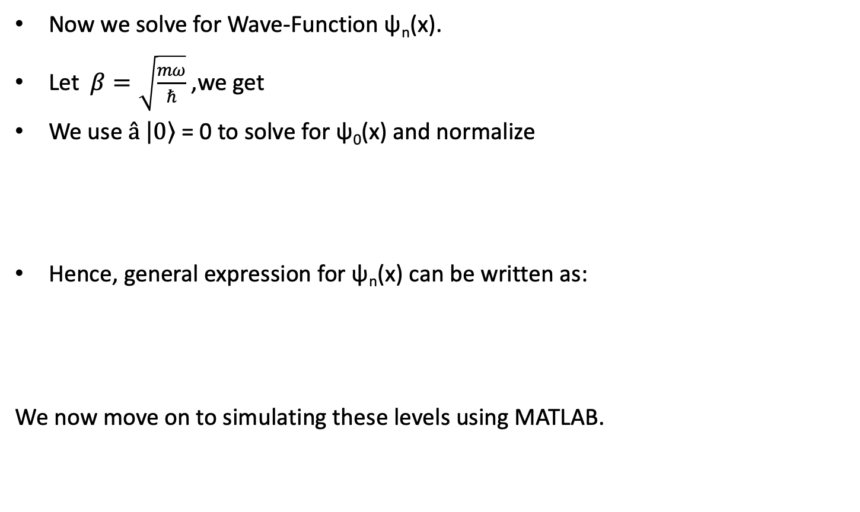
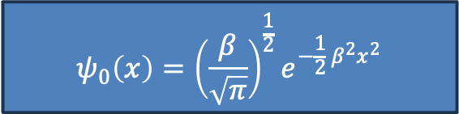
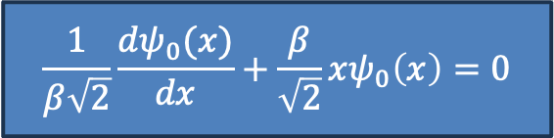
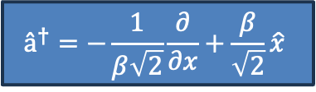
Review – Quantum Harmonic Oscillator
Now we solve for Wave-Function ψ_{n}(x).
Let $β=\sqrt{\frac{mω}{ℏ}}$ ,we get
We use $â \left|\left.0\right\rangle \right.$ = 0 to solve for ψ₀(x) and normalize
Hence, general expression for ψ_{n}(x) can be written as:
We now move on to simulating these levels using MATLAB.
$â=\frac{1}{β\sqrt{2}}\frac{d}{dx}+\frac{β}{\sqrt{2}}\hat{x}$
$$â^{†}=−\frac{1}{β\sqrt{2}}\frac{∂}{∂x}+\frac{β}{\sqrt{2}}\hat{x}$$
$$\frac{1}{β\sqrt{2}}\frac{dψ_{0}(x)}{dx}+\frac{β}{\sqrt{2}}xψ_{0}\left(x\right)=0$$
$$ψ_{0}\left(x\right)={\left(\frac{β}{\sqrt{π}}\right)}^{\frac{1}{2}}e^{−\frac{1}{2}{ β}^{2}x^{2}}$$
$${ψ_{n}\left(x\right)= â^{†} ψ}_{n−1}\left(x\right)/\sqrt{n} {ψ_{n}\left(x\right)={\left(â^{†}\right)}^{n} ψ}_{0}\left(x\right)/\sqrt{n!}$$
[2] Principles of Quantum Mechanics Tyagi, S. Tyagi, I.S. 9789332517721 2012 Dorling Kindersley (India)

Slide 12
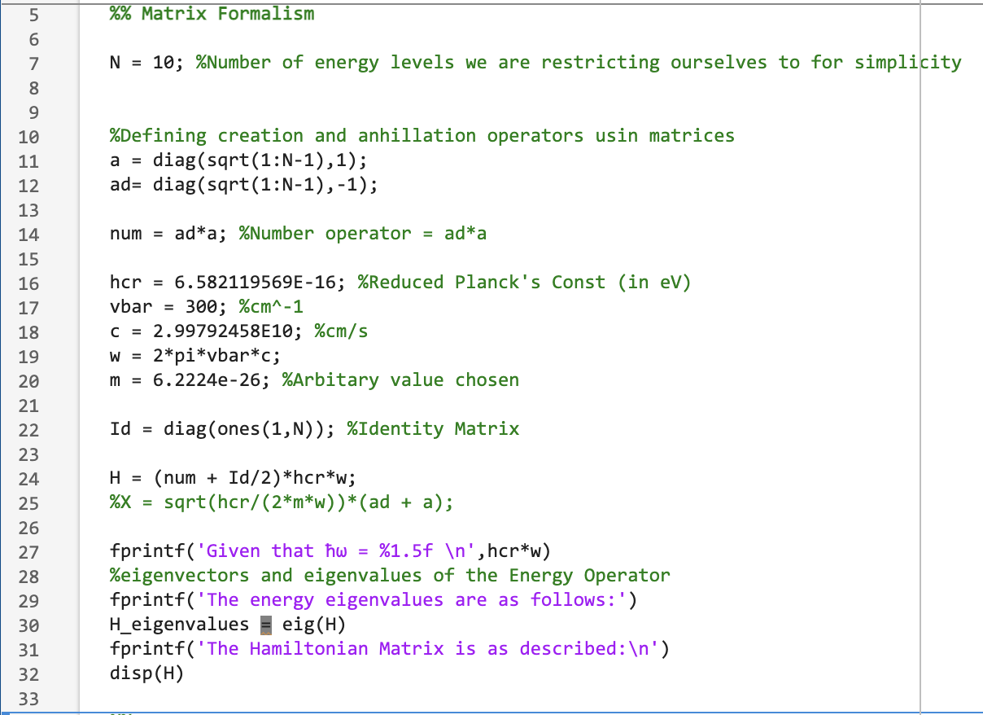
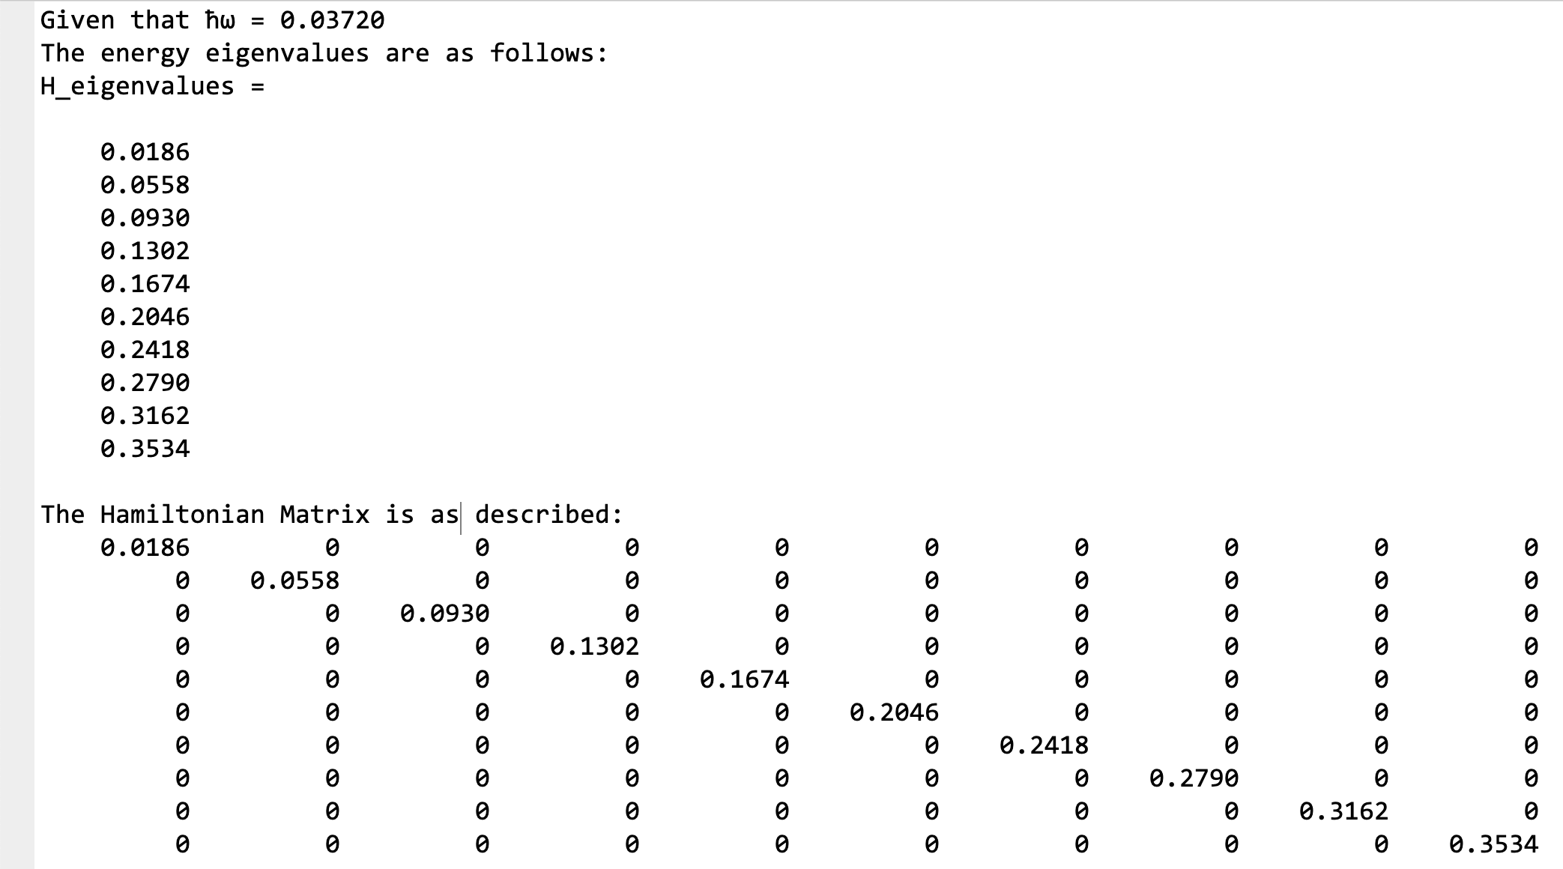
Simulation of QHO Energy Levels using MATLAB
Obtaining Energy Levels

Slide 13
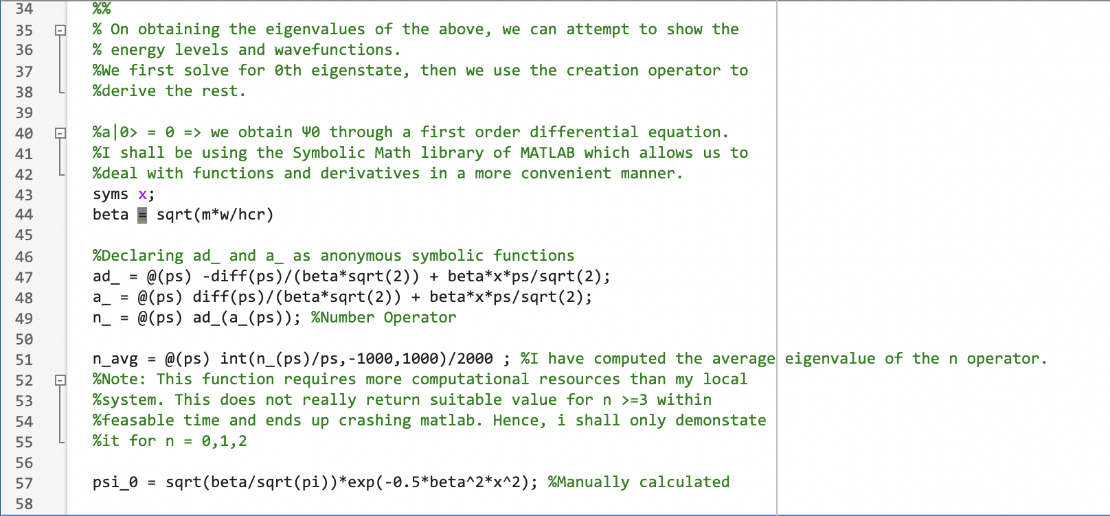
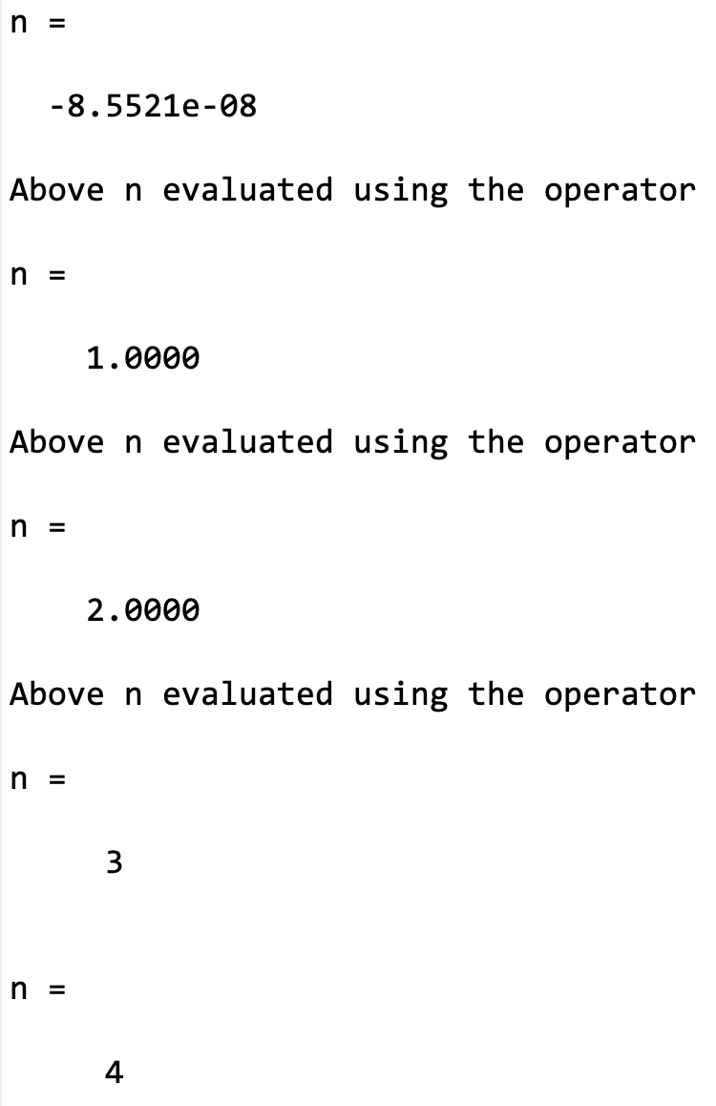
Simulation of QHO Energy Levels using MATLAB
Obtaining Eigenstates

Slide 14
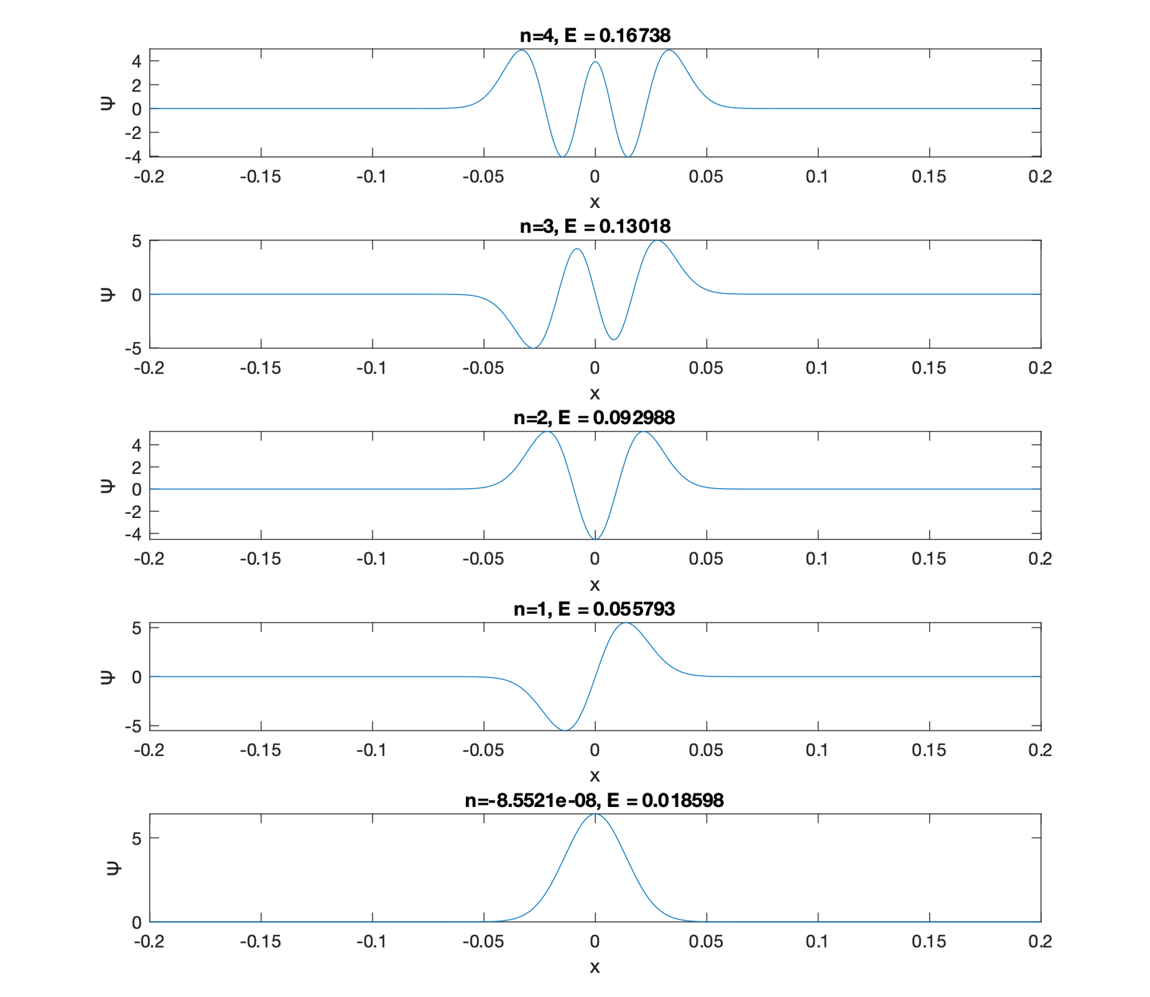
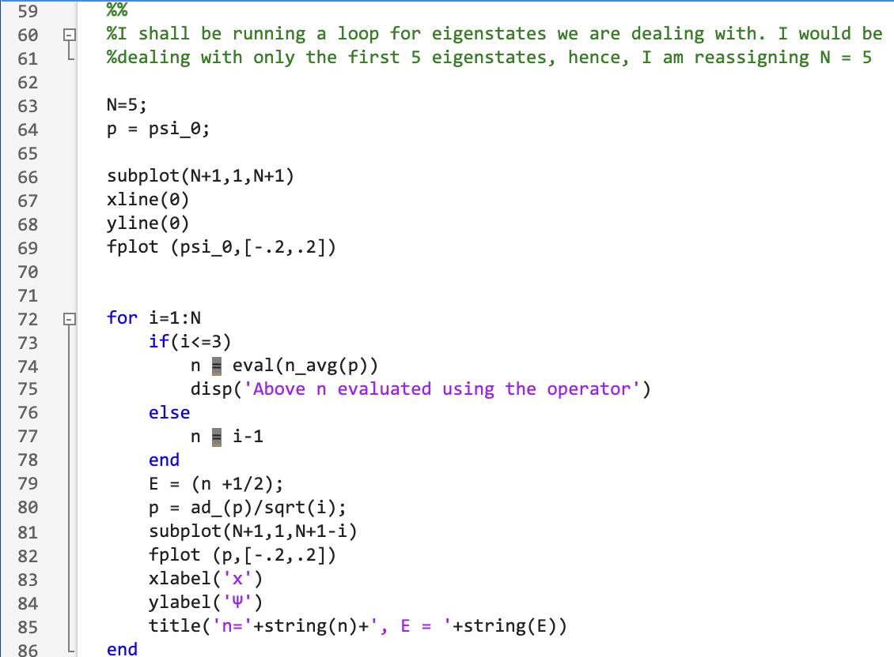
Simulation of QHO Energy Levels using MATLAB

Slide 15
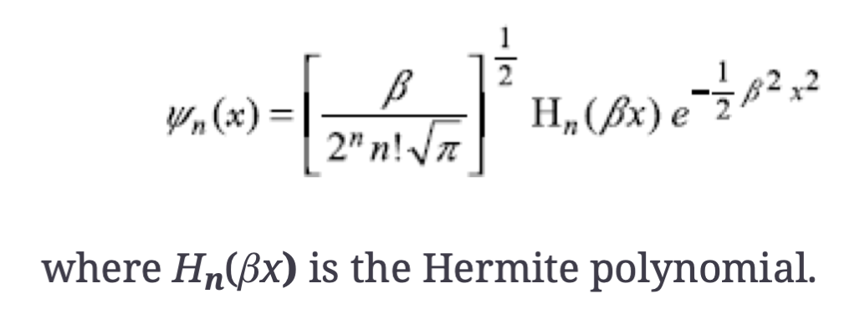
Review – Quantum Harmonic Oscillator
Theoretically, the solution should be of this form:
I decided to instead numerically calculate the eigenstates instead of using this general result.
[2] Principles of Quantum Mechanics Tyagi, S. Tyagi, I.S. 9789332517721 2012 Dorling Kindersley (India)

Slide 16
The linear harmonic oscillator system might not offer great control; hence for further study it is essential that we try to obtain similar energy levels through other means.
It is well established that the LC Circuit is also governed by a 2nd order differential equation similar to a Classical Linear Harmonic Oscillator. Hence, the energy level distribution obtained on quantum mechanical treatment using different coordinates instead of position and momentum should be similar.
We shall assess the Hamiltonian of the LC Oscillator in the next section.

Slide 17
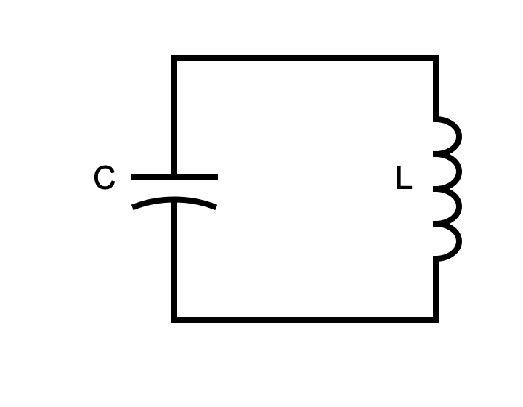
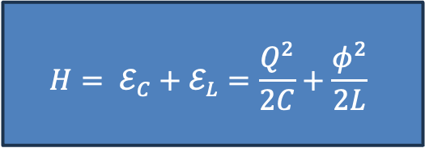
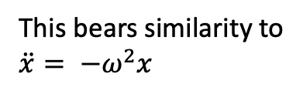
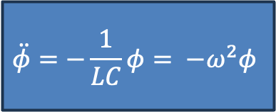
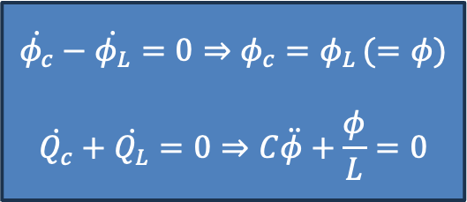
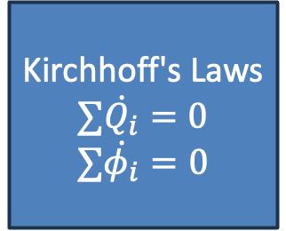
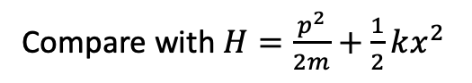
Quantum Mechanical Treatment of the LC Oscillator Circuit
We can derive the Hamiltonian of the LC Circuit and observe similarities to the Linear Harmonic Oscillator
Kirchhoff's Laws
$∑\dot{Q_{i}}=0$
$∑\dot{φ_{i}}=0$
$$\dot{φ_{c}}−\dot{φ_{L}}=0⇒φ_{c}=φ_{L }(=φ)$$
$$\dot{Q_{c}}+\dot{Q_{L}}=0⇒C\ddot{φ}+\frac{φ}{L}=0$$
$$\ddot{φ}=−\frac{1}{LC}φ= −ω^{2}φ$$
$$H= ℰ_{C}+ℰ_{L}=\frac{Q^{2}}{2C}+\frac{φ^{2}}{2L}$$
This bears similarity to
$\ddot{x}= −ω^{2}x$
Compare with $H=\frac{p^{2}}{2m}+\frac{1}{2}kx^{2}$
[4] Lectures 16-21 (Zlatko K. Minev), 2020 Qiskit Global Summer School on Quantum Computing and Quantum Hardware

Slide 18
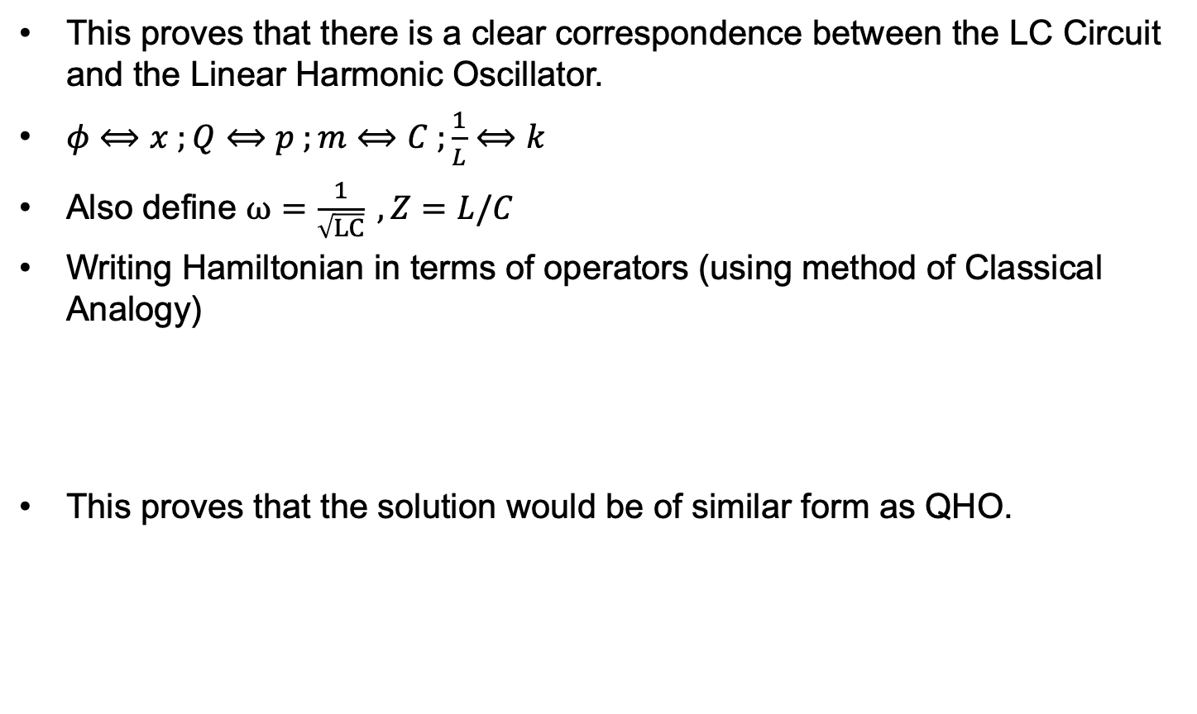
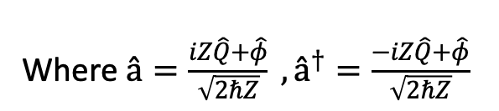
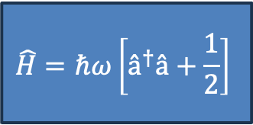
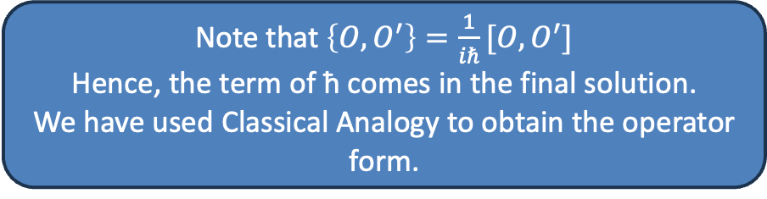
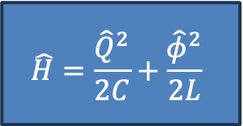
Quantum Mechanical Treatment of the LC Oscillator Circuit
This proves that there is a clear correspondence between the LC Circuit and the Linear Harmonic Oscillator.
$φ⟺x ;Q⟺p ;m⟺C ;\frac{1}{L}⟺k$
Also define $ω=\frac{1}{\sqrt{LC}} , Z=L/C$
Writing Hamiltonian in terms of operators (using method of Classical Analogy)
This proves that the solution would be of similar form as QHO.
Note that $\left\{O,O^{′}\right\}=\frac{1}{iℏ}[O,O^{′}]$
Hence, the term of ħ comes in the final solution.
We have used Classical Analogy to obtain the operator form.
$$\hat{H}=\frac{{\hat{Q}}^{2}}{2C}+\frac{{\hat{φ}}^{2}}{2L}$$
$$\hat{H}=ℏω\left[â^{†}â+\frac{1}{2}\right]$$
Where $â=\frac{iZ\hat{Q}+\hat{φ}}{\sqrt{2ℏZ}} ,â^{†}=\frac{−iZ\hat{Q}+\hat{φ}}{\sqrt{2ℏZ}}$
[4] Lectures 16-21 (Zlatko K. Minev), 2020 Qiskit Global Summer School on Quantum Computing and Quantum Hardware

Slide 19
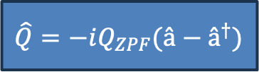
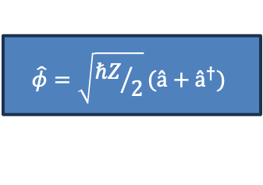
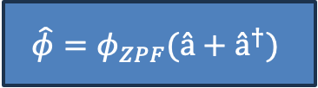
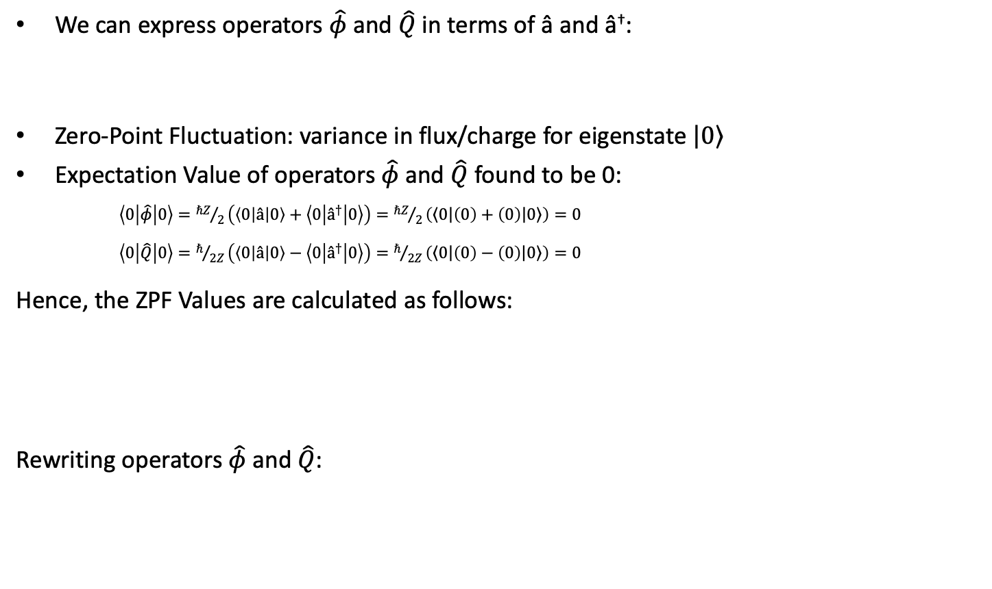
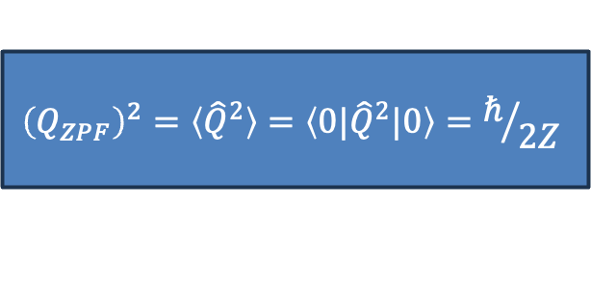
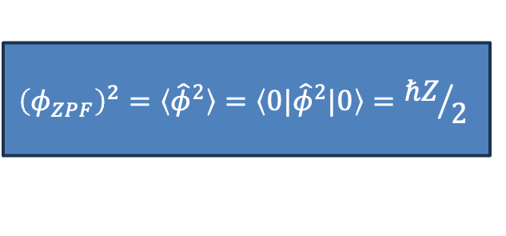
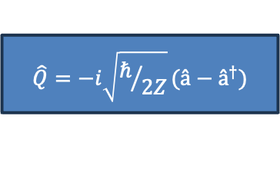
Quantum Mechanical Treatment of the LC Oscillator Circuit
We can express operators $\hat{φ}$ and $\hat{Q}$in terms of â and â†:
Zero-Point Fluctuation: variance in flux/charge for eigenstate $\left|\left.0\right\rangle \right.$
Expectation Value of operators $\hat{φ}$ and $\hat{Q}$ found to be 0:
$\left\langle 0 | \hat{φ} | 0\right\rangle ={ℏZ}/2\left(\left\langle 0 | â | 0\right\rangle +\left\langle 0 | â^{†} | 0\right\rangle \right)={ℏZ}/2\left(\left\langle \left.0\right|\right.\left(0\right)+\left(0\right)\left|\left.0\right\rangle \right.\right)=0$
$\left\langle 0 | \hat{Q} | 0\right\rangle =ℏ/{2Z}\left(\left\langle 0 | â | 0\right\rangle −\left\langle 0 | â^{†} | 0\right\rangle \right)=ℏ/{2Z}\left(\left\langle \left.0\right|\right.\left(0\right)−\left(0\right)\left|\left.0\right\rangle \right.\right)=0$
Hence, the ZPF Values are calculated as follows:
Rewriting operators $\hat{φ}$ and $\hat{Q}$:
$$\hat{φ}=\sqrt{{ℏZ}/2}(â+â^{†})$$
$$\hat{Q}=−i\sqrt{ℏ/{2Z}}(â−â^{†})$$
$${\left(φ_{ZPF}\right)}^{2}=〈{\hat{φ}}^{2}〉=〈{0|\hat{φ}}^{2}|0〉={ℏZ}/2$$
$${\left(Q_{ZPF}\right)}^{2}=〈{\hat{Q}}^{2}〉=〈{0|\hat{Q}}^{2}|0〉=ℏ/{2Z}$$
$$\hat{φ}=φ_{ZPF}(â+â^{†})$$
$$\hat{Q}=−iQ_{ZPF}(â−â^{†})$$
[4] Lectures 16-21 (Zlatko K. Minev), 2020 Qiskit Global Summer School on Quantum Computing and Quantum Hardware

Slide 20
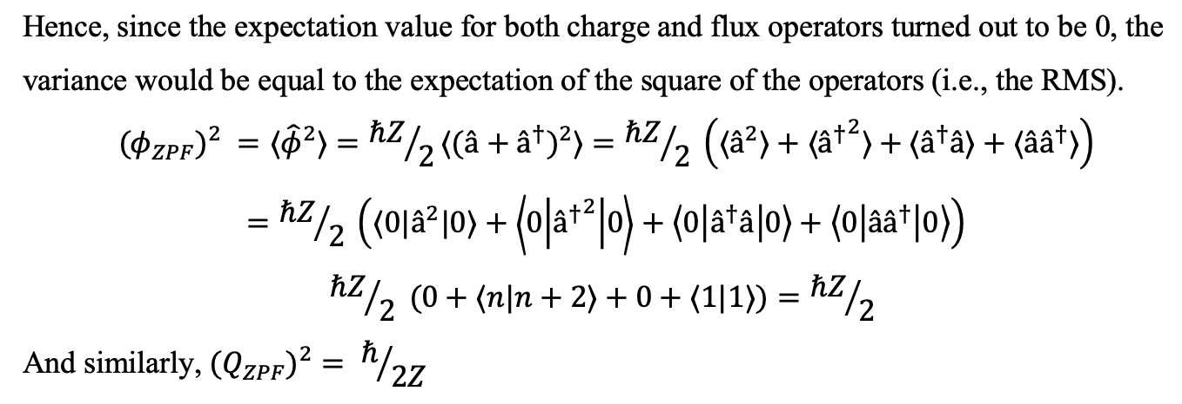
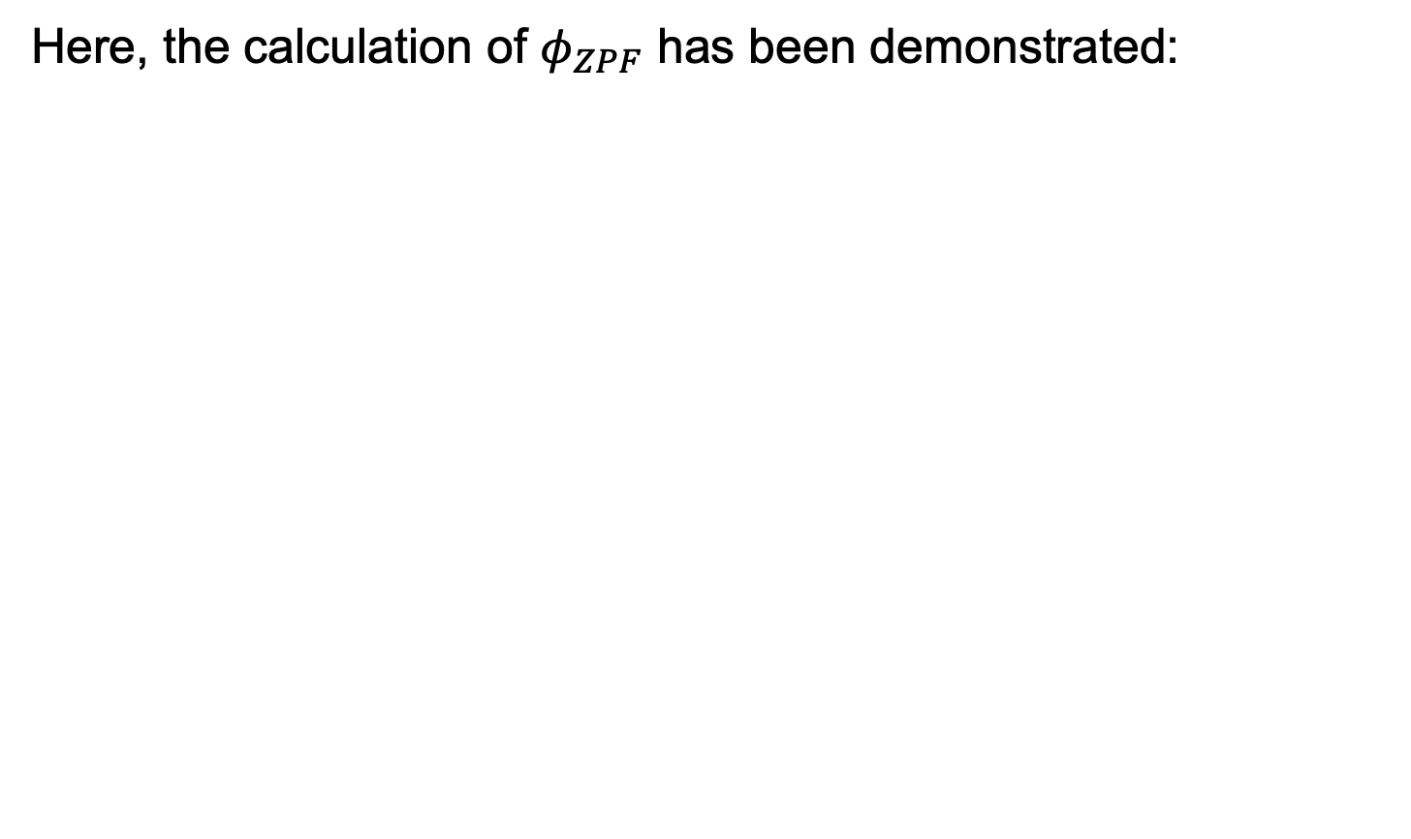
Quantum Mechanical Treatment of the LC Oscillator Circuit
Here, the calculation of $φ_{ZPF}$ has been demonstrated:
[4] Lectures 16-21 (Zlatko K. Minev), 2020 Qiskit Global Summer School on Quantum Computing and Quantum Hardware

Slide 21
Limitations of Harmonic Oscillator Systems
For a qubit, we need to isolate two energy levels such that the system effectively acts like a two-level quantum system.
However, here, we cannot isolate two levels as the transition frequency between subsequent levels are equal, hence none of the transitions are unique to two fixed energy levels.

Slide 22



Anharmonicity and Introduction to the Transmon Qubit
The Hamiltonian of the Anharmonic Oscillator is given by:
$$\hat{H}=\frac{{\hat{p}}^{2}}{2m}+\frac{1}{2}mω^{2}{\hat{x}}^{2}−λ{\hat{x}}^{4}$$
(We shall not solve it, but shall attempt to numerically find its eigenstates and energy eigenvalues)
The Transmon Qubit can be thought of as replacing the Inductor in a regular LC Oscillator with a Non-Linear Element known as the Josephson Junction.
[4] Lectures 16-21 (Zlatko K. Minev), 2020 Qiskit Global Summer School on Quantum Computing and Quantum Hardware

Slide 23




Anharmonicity and Introduction to the Transmon Qubit
Energy of Josephson Junction:
Hence, Hamiltonian of the JJ-Oscilator:
L_{j} = Effective Linear Inductance
Clearly, the system resembles an
anharmonic oscillator on neglecting
higher order terms.
$ℰ_{j}=E_{j}\left(1−\cos\left(\frac{φ_{j}}{φ_{0}}\right)\right)≈E_{j}\left(\frac{{\left(\frac{φ_{j}}{φ_{0}}\right)}^{2}}{2!}−\frac{{\left(\frac{φ_{j}}{φ_{0}}\right)}^{4}}{4!}+H.O.T.\right)$
$$H= ℰ_{C}+ℰ_{j}=\frac{Q^{2}}{2C}+E_{j}\left(\frac{{\left(\frac{φ_{j}}{φ_{0}}\right)}^{2}}{2!}−\frac{{\left(\frac{φ_{j}}{φ_{0}}\right)}^{4}}{4!}+...\right)$$
Substituting
$E_{j}=φ_{0}^{2}/L_{j}$
In Hamiltonian
$$H=\frac{Q^{2}}{2C}+\frac{{φ_{j}}^{2}}{2L_{j}}−\frac{{φ_{j}}^{4}}{φ_{0}^{2}L_{j}4!}+ ⋯$$
[4] Lectures 16-21 (Zlatko K. Minev), 2020 Qiskit Global Summer School on Quantum Computing and Quantum Hardware

Slide 24

Anharmonicity and Introduction to the Transmon Qubit
We can write our Hamiltonian as:
We shall now examine the energy levels of the anharmonic oscillator. I have used a numerical approach to approximate the energy levels of such systems.
$$\hat{H}=\frac{{\hat{Q}}^{2}}{2C}+\frac{{{\hat{φ}}_{j}}^{2}}{2L}−\frac{{{\hat{φ}}_{j}}^{4}}{L_{j}4!}={\hat{H}}_{QHO}−\frac{{{\hat{φ}}_{j}}^{4}}{{φ_{0}^{2}L}_{j}4!}$$
[4] Lectures 16-21 (Zlatko K. Minev), 2020 Qiskit Global Summer School on Quantum Computing and Quantum Hardware

Slide 25


Anharmonicity and Introduction to the Transmon Qubit
Here is a review on the result obtained if the Hamiltonian of the Transmon is calculated. I have not derived this result and am only including this for reference.
Deriving this required knowledge of RWA and 1st Order Perturbation Theory, which I have not explored as a part of the project, hence I resorted to a numerical method for calculating the energy eigenvalues.
Kerr Hamiltonian

Slide 26

Simulating 1-D Potentials using MATLAB
Solving these equations can be cumbersome. Hence, we rely on numerical methods.
The method I have used to solve the AHO revolves around dividing our space into N points and using a discrete version of the Schrodinger Equation to obtain the Wave Function and Energy Eigenvalues.
If we assume the wave function at the j^{th} point to be $ψ_{j}$, then the 2nd derivative can be expressed in a discrete form in terms of $ψ_{j}$, $ψ_{j+1}$ and $ψ_{j−1}$. Hence for j = 1 to N-1 we get N-1 equations.
For j=0 and j=N, we apply certain boundary conditions. Since we are not dealing with infinite space here, we have to assume that our particle would be bounded at these points. By taking N to be very large and assessing only the lower energy eigenstates, we can approximate for an unbounded system.
[3] Luke Polson Physics Blog - Numerically Finding the Eigenstates/Energies of a 1D Quantum System

Slide 27

Simulating 1-D Potentials using MATLAB
In this method, we use an approximation that the system has the boundary conditions:
$$ψ\left(0\right)=ψ\left(L\right)=0$$
i.e., the particle is bounded from x=0 to x=L.
For a 1-D potential, the Time Independent Schrodinger Equation is written as:
$$−\frac{ℏ^{2}}{2m}\frac{∂^{2}ψ}{∂x^{2}}+V\left(x\right)ψ=Eψ$$
Let us use the convention ħ=1, and non-dimensionalise the equation by expressing x = L*y,
$$−\frac{1}{2}\frac{d^{2}ψ}{dy^{2}}+mL^{2}V\left(y\right)ψ=mL^{2}Eψ$$
Note that Boundary Conditions still hold, so $ψ\left(y=0\right)=ψ\left(y=1\right)=$ 0
[3] Luke Polson Physics Blog - Numerically Finding the Eigenstates/Energies of a 1D Quantum System

Slide 28


Simulating 1-D Potentials using MATLAB
We use a discrete definition of the 2nd Derivative:
$${\frac{d^{2}ψ}{dy^{2}}}_{y=j∆y}≈\frac{ψ_{j+1}−2ψ_{j}+ψ_{j−1}}{∆y^{2}}$$
Substitute in S.E.:
$$−\frac{1}{2}\left(\frac{ψ_{j+1}−2ψ_{j}+ψ_{j−1}}{∆y^{2}}\right)+mL^{2}V_{j}ψ_{j}=mL^{2}Eψ_{j}$$
⇒ $−\frac{1}{2∆y^{2}}ψ_{j+1}+\left(\frac{1}{∆y^{2}}+mL^{2}V_{j}\right)ψ_{j}−\frac{1}{2∆y^{2}}ψ_{j−1}=mL^{2}Eψ_{j} (for j=1 to N−1)$
Express above family in matrix form for j = 1 to N-1
$$\left[\begin{matrix}\begin{matrix}\frac{1}{∆y^{2}}+mL^{2}V_{1} & −\frac{1}{2∆y^{2}} & 0 \\ −\frac{1}{2∆y^{2}} & \frac{1}{∆y^{2}}+mL^{2}V_{2} & −\frac{1}{2∆y^{2}} \\ 0 & −\frac{1}{2∆y^{2}} & \frac{1}{∆y^{2}}+mL^{2}V_{3}\end{matrix} & ⋯ & 0 \\ ⋮ & ⋱ & ⋮ \\ 0 & ⋯ & \frac{1}{∆y^{2}}+mL^{2}V_{N−1}\end{matrix}\right]\left[\begin{matrix}ψ_{1} \\ ψ_{2} \\ \begin{matrix}ψ_{3} \\ ⋮ \\ ψ_{N−1}\end{matrix}\end{matrix}\right]=mL^{2}E\left[\begin{matrix}ψ_{1} \\ ψ_{2} \\ \begin{matrix}ψ_{3} \\ ⋮ \\ ψ_{N−1}\end{matrix}\end{matrix}\right]$$
[3] Luke Polson Physics Blog - Numerically Finding the Eigenstates/Energies of a 1D Quantum System

Slide 29
Simulating 1-D Potentials using MATLAB
Using this equation, we can obtain the energy levels through the eigenvalues of our LHS Matrix and hence find the corresponding Eigenstates.
I have solved for the following systems:
Linear Harmonic Oscillator
Anharmonic Oscillator (additional quartic term)
[3] Luke Polson Physics Blog - Numerically Finding the Eigenstates/Energies of a 1D Quantum System

Slide 30


Simulating 1-D Potentials using MATLAB
Linear Harmonic Oscillator

Slide 31

Simulating 1-D Potentials using MATLAB
Result for Linear Harmonic Oscillator

Slide 32


Simulating 1-D Potentials using MATLAB
Anharmonic Oscillator

Slide 33

Simulating 1-D Potentials using MATLAB
Result for Anharmonic Oscillator

Slide 34
Simulating 1-D Potentials using MATLAB
Findings:
We were able to get a fairly accurate approximation for the Harmonic Oscillator Potential as the energy levels were equally spaced for lower levels of N.
The anharmonic oscillator has roughly similar eigenstates but the energy levels are spaced unequally and the gap between energy levels decreases as we go on to higher energy eigenvalues.
Hence, in an anharmonic oscillator type system, we can separate the lower two energy states and use them as our basis states.
Since the Josephson Junction Oscillator has a Hamiltonian similar to the Anharmonic Oscillator, we can use it to construct our Transmon Qubit

Slide 35
Now that we have learnt about the construction of the qubit, we shall dive into the mathematical representation of the state of a qubit.
It is important to understand that for any multi-level quantum system, we can express it as a superposition of some basis states. Here, we isolate two energy levels of the AHO type system and assign one to be our ‘0’ state and the other to be our ‘1’ state.
However, as we know from basic quantum mechanics, the system's state can be described as a superposition of its basis states. We shall use the matrix formalism and the Dirac notation to represent the system's state as a linear combination of orthonormal vectors that correspond to the chosen basis states.

Slide 36

Basics of the Qubit
For some time, we shall move away from the physical picture of the qubit and shift towards a more mathematical picture.
As defined in the beginning of the report, the state of a qubit can be represented as a superposition of its two basis states:
$$\left|\left.ψ\right\rangle \right.=α\left|\left.0\right\rangle \right.+β\left|\left.1\right\rangle \right.$$
Here α and β are complex coefficients such that |α|² + |β|² = 1 (Obvious result of normalization).
|α|² and |β|² denote the probabilities of obtaining the respective basis state on measurement.
The basis states $\left|\left.0\right\rangle \right.$ and $\left|\left.1\right\rangle \right.$ can be expressed in vector form as follows:
$$\left|\left.0\right\rangle \right.=\left(\begin{matrix}1 \\ 0\end{matrix}\right) , \left|\left.1\right\rangle \right.=\left(\begin{matrix}0 \\ 1\end{matrix}\right)$$

Slide 37

Bloch Sphere Representation
We now wish to visualize the state of the qubit geometrically. Note that α and β are complex coefficients and hence have their own magnitudes and arguments, giving us 4 degrees-of-freedom required to visualise information. Hence, we would need to use 4 dimensions to visualise the state of a qubit.
It is important to realise that multiplying the state with any additional phase would not impact the relative phase between the basis states, and hence information about the global phase can be neglected, since it is only the local phase which impacts interaction with gates and other qubits. This reduces our problem to 3 degrees-of-freedom.
So, if $α=ae^{iφ_{a}}$ and $β=be^{iφ_{b}}$ (where a and b ∈ ℝ⁺) then our state can be written as:
$$\left|\left.ψ\right\rangle \right.=ae^{iφ_{a}} \left|\left.0\right\rangle \right.+be^{iφ_{b}}\left|\left.1\right\rangle \right.=e^{iφ_{a}}\left(a \left|\left.0\right\rangle \right.+be^{i{(φ}_{b}−φ_{a})}\left|\left.1\right\rangle \right.\right)$$
We neglect $e^{iφ_{a}}$ since it contains information only about global phase. Hence our state reduces to:
$$\left|\left.ψ\right\rangle \right.=a \left|\left.0\right\rangle \right.+be^{iφ}\left|\left.1\right\rangle \right.$$
Where $φ_{b}−φ_{a}=φ$ and is called ‘Local Phase’

Slide 38


Bloch Sphere Representation
We have already reduced our problem to 3-degrees of freedom and the state of the system is a function of a, b and φ.
We also have another constraint a² + b² = 1 , which gives us the idea of a trigonometric relationship between a and b. If we substitute a and b as functions of some angle θ such that any arbitrary state can be represented by a unique point on a unit sphere.
We substitute a=cos(θ/2) and b=sin(θ/2)
Hence, our state is represented as:
Refer to diagram attached:
Any point (r=1, θ, φ) can be used to represent
the state of a qubit.
$$\left|\left.ψ\right\rangle \right.=\cos\left(\frac{θ}{2}\right)\left|\left.0\right\rangle \right.+e^{iφ}\sin\left(\frac{θ}{2}\right)\left|\left.1\right\rangle \right.$$
[12] Photograph by Smite-Meister, distributed under a CC BY-SA 3.0 license

Slide 39

Density Matrix Representation of a Qubit
The state of a qubit can be represented by its density matrix as well.
The density matrix can also represent mixed and entangled states as well, and is hence also frequently used.
$$ρ=\left|\left.ψ\right\rangle \left\langle ψ\right.\right|=\left[\begin{matrix}{\left|α\right|}^{2} & αβ^{∗} \\ α^{∗}β & {\left|β\right|}^{2}\end{matrix}\right]=\left[\begin{matrix}\cos^{2}\left(\frac{θ}{2}\right) & e^{−iφ}\cos\left(\frac{θ}{2}\right)sin\left(\frac{θ}{2}\right) \\ e^{iφ}\cos\left(\frac{θ}{2}\right)sin\left(\frac{θ}{2}\right) & \sin^{2}\left(\frac{θ}{2}\right)\end{matrix}\right]$$
[1] Sangil Kwon, Akiyoshi Tomonaga, Gopika Lakshmi Bhai, Simon J. Devitt, Jaw-Shen Tsai; Gate-based superconducting quantum computing. Journal of Applied Physics 28 January 2021; 129 (4): 041102

Slide 40
Primer into Classical Gates
Now that we have studied the Bloch Sphere Representation as well as Density Matrix Representation, we shall proceed towards our assessment of various quantum gates.
However, it is essential that we do a brief review of classical logic gates as well so we can compare them and study the differences and challenges.

Slide 41
Primer into Classical Gates
There are 6 Main Classical Logic Gates
AND Gate
OR Gate
NOT Gate
NAND Gate
NOR Gate
XOR Gate
These are non-reversible. There also exist some reversible gates such as Toffoli and Fredkin Gates. However, these gates are also central to Quantum Computing and we shall see these gates when reviewing Multi-Qubit Quantum Gates

Slide 42
Primer into Classical Gates
AND GATE
OR GATE
Diagram
Boolean Representation
Truth Table
A•B
Diagram
Boolean Representation
Truth Table
A+B

Slide 43
Primer into Classical Gates
NAND GATE
NOR GATE
Diagram
Boolean Representation
Truth Table
(A•B)’ = A’+B’
Diagram
Boolean Representation
Truth Table
(A+B)’ = A’•B’

Slide 44
Primer into Classical Gates
NOT GATE
XOR GATE
Diagram
Boolean Representation
Truth Table
A’
Diagram
Boolean Representation
Truth Table
A⊕B

Slide 45










Universality in Classical Gates
The NAND and NOR Gates are called universal since you can build any gate using NAND or
NOR Gates
NAND
NOR
AND
OR
NOT
NOR
XOR
AND
OR
NOT
NAND
XOR

Slide 46
Classical v/s Quantum Gates
Classical Gates are implemented using Transistors. They operate on Boolean Logic and are hence used to solve Boolean Functions.
The major difference between Classical and Quantum Gates are their implementation.
A qubit’s construction is fundamentally different from that of a classical bit, which is normally just stored in terms of voltages ‘High’ and ‘Low’.
We tend to use quantum mechanical systems in qubits where the state is determined by the energy level or the spin associated with the system.
Hence, unlike classical gates, Quantum Gates are realised via pulses.
We have already talked about the Bloch sphere representation of the qubit before taking a detour into classical gates. We shall see how a Quantum Gate operation is represented geometrically.

Slide 47

Single-Qubit Quantum Gates as Rotations on Bloch Sphere
A quantum gate can be described as a unitary evolution of the state of the qubit. They are designed such that the resulting unitary evolution of the qubit implements the target gate.
$$\hat{U}\left(t\right)=e^{−\frac{i\hat{H}t}{ℏ}}$$
The action of a single-qubit gate can be expressed as a series of rotations on the Bloch Sphere.
We can also represent gates by matrices. We shall start with representing rotations on the Bloch Sphere via Matrices.
[12] Photograph by Smite-Meister, distributed under a CC BY-SA 3.0 license
[1] Sangil Kwon, Akiyoshi Tomonaga, Gopika Lakshmi Bhai, Simon J. Devitt, Jaw-Shen Tsai; Gate-based superconducting quantum computing. Journal of Applied Physics 28 January 2021; 129 (4): 041102

Slide 48




Single-Qubit Quantum Gates as Rotations on Bloch Sphere
There are namely 3 axes, i.e., the X, Y and Z axes. The coordinates of the state-vector in terms of cartesian coordinates can be written as:
$$\left(sin\left(θ\right)\cos\left(φ\right),sin\left(θ\right)sin\left(φ\right) , cos\left(θ\right)\right)$$
The matrices associated with Rotation by angle Ω about X, Y and Z axes are shown below:
These are all unitary matrices. Note that these are not necessarily reversible. All the conventional gates used in most Quantum Computing can be expressed as a sequence of rotations.
$$R_{x}\left(Ω\right)=\left[\begin{matrix}\cos\left(\frac{Ω}{2}\right) & −i\sin\left(\frac{Ω}{2}\right) \\ −i\sin\left(\frac{Ω}{2}\right) & \cos\left(\frac{Ω}{2}\right)\end{matrix}\right]$$
$$R_{y}\left(Ω\right)=\left[\begin{matrix}\cos\left(\frac{Ω}{2}\right) & −\sin\left(\frac{Ω}{2}\right) \\ \sin\left(\frac{Ω}{2}\right) & \cos\left(\frac{Ω}{2}\right)\end{matrix}\right]$$
$$R_{z}\left(Ω\right)=\left[\begin{matrix}e^{−\frac{iΩ}{2}} & 0 \\ 0 & e^{\frac{iΩ}{2}}\end{matrix}\right]$$
$$\left(or\left[\begin{matrix}1 & 0 \\ 0 & e^{iΩ}\end{matrix}\right] \right)$$

Slide 49
Types of Gates
We shall see the following categories of gates
Quantum Gates
Single Qubit
Multiple Qubit
Pauli Gates
Hadamard Gate
Phase Gates
Pauli-X
Pauli-Y
Pauli-Z
S Gate
T Gate
2-Qubit Gates
CNOT
CZ
SWAP
3-Qubit Gates
Toffoli Gate

Slide 50
Pauli Gates
Pauli Gates are described as 180º rotations along the X, Y and Z Axes.
These comprise of 3 Gates:
Pauli-X
Pauli-Y
Pauli-Z
We shall look into each of these gates one-by-one.
(Note: The Gate Symbols have mostly been drawn using IBM’s Quantum Composer, and hence I have referenced IBM as well.)

Slide 51






Pauli-X Gate
The Pauli-X Gate represents a 180º Rotation about the X-Axis.
This gate is also called the ‘Bit-Flip’ Gate and is the Quantum Analogue of the classical NOT gate.
The matrix representation and gate action is shown below:
This gate is reversible.
$$X=R_{x}\left(π\right)=\left[\begin{matrix}0 & 1 \\ 1 & 0\end{matrix}\right]=\left|\left.0\right\rangle \left\langle 1\right.\right|+\left|\left.1\right\rangle \left\langle 0\right.\right|$$
Symbol:
$$X\left|\left.0\right\rangle =\right.\left[\begin{matrix}0 & 1 \\ 1 & 0\end{matrix}\right]\left(\begin{matrix}1 \\ 0\end{matrix}\right)=\left(\begin{matrix}0 \\ 1\end{matrix}\right)=\left|\left.1\right\rangle \right.$$
$$X\left|\left.1\right\rangle =\right.\left[\begin{matrix}0 & 1 \\ 1 & 0\end{matrix}\right]\left(\begin{matrix}0 \\ 1\end{matrix}\right)=\left(\begin{matrix}1 \\ 0\end{matrix}\right)=\left|\left.0\right\rangle \right.$$
$$X\left(α\left|\left.0\right\rangle \right.+β\left|\left.1\right\rangle \right.\right)=α\left|\left.1\right\rangle \right.+β\left|\left.0\right\rangle \right.$$
[7] IBM Quantum. https://quantum-computing.ibm.com/, 2021

Slide 52





Pauli-Z Gate
The Pauli-X Gate represents a 180º Rotation about the Z-Axis.
This gate is also called the ‘Phase-Flip’ Gate as it changes the phase by a factor of π
The matrix representation and gate action is shown below:
This gate is reversible.
$$Z=R_{Z}\left(π\right)= \left[\begin{matrix}1 & 0 \\ 0 & −1\end{matrix}\right]=\left|\left.0\right\rangle \left\langle 0\right.\right|−\left|\left.1\right\rangle \left\langle 1\right.\right|$$
Symbol:
$$Z\left|\left.0\right\rangle =\right.\left[\begin{matrix}1 & 0 \\ 0 & −1\end{matrix}\right]\left(\begin{matrix}1 \\ 0\end{matrix}\right)=\left(\begin{matrix}1 \\ 0\end{matrix}\right)=\left|\left.0\right\rangle \right.$$
$$Z\left|\left.1\right\rangle =\right.\left[\begin{matrix}1 & 0 \\ 0 & −1\end{matrix}\right]\left(\begin{matrix}0 \\ 1\end{matrix}\right)=\left(\begin{matrix}0 \\ −1\end{matrix}\right)=−\left|\left.1\right\rangle \right.$$
$$Z\left(α\left|\left.0\right\rangle \right.+β\left|\left.1\right\rangle \right.\right)=α\left|\left.0\right\rangle \right.−β\left|\left.1\right\rangle \right.$$
[7] IBM Quantum. https://quantum-computing.ibm.com/, 2021

Slide 53





Pauli-Y Gate
The Pauli-Y Gate represents a 180º Rotation about the Y-Axis.
This gate does both a bit and a phase flip. It can be used when we wish to flip the bits and bring about an additional phase of π.
The matrix representation and gate action is shown below:
This gate is reversible.
$$Y=R_{Y}\left(π\right)=\left[\begin{matrix}0 & −i \\ i & 0\end{matrix}\right]=i\left|\left.1\right\rangle \left\langle 0\right.\right|−i\left|\left.0\right\rangle \left\langle 1\right.\right|$$
Symbol:
$$Y\left|\left.0\right\rangle =\right.\left[\begin{matrix}0 & −i \\ i & 0\end{matrix}\right]\left(\begin{matrix}1 \\ 0\end{matrix}\right)=\left(\begin{matrix}0 \\ i\end{matrix}\right)=i\left|\left.1\right\rangle \right.$$
$$Y\left|\left.1\right\rangle =\right.\left[\begin{matrix}0 & −i \\ i & 0\end{matrix}\right]\left(\begin{matrix}0 \\ 1\end{matrix}\right)=\left(\begin{matrix}−i \\ 0\end{matrix}\right)=−i\left|\left.0\right\rangle \right.$$
$$Y\left(α\left|\left.0\right\rangle \right.+β\left|\left.1\right\rangle \right.\right)=i(α\left|\left.1\right\rangle \right.−β\left|\left.0\right\rangle \right.)$$
[7] IBM Quantum. https://quantum-computing.ibm.com/, 2021

Slide 54





Hadamard Gate
The Hadamard Gate is one of the most important gates as it has the ability to generate superposition states.
It can be represented either by a 180º rotation about the line z=x, or via a rotation of π/2 about Y axis followed by a rotation of π about the X axis.
$$H=R_{x}\left(π\right)R_{y}\left(\frac{π}{2}\right)=\frac{1}{\sqrt{2}}\left[\begin{matrix}1 & 1 \\ 1 & −1\end{matrix}\right]$$
Symbol:
$$H\left|\left.0\right\rangle \right.=\frac{1}{\sqrt{2}}(\left|\left.0\right\rangle \right.+\left|\left.1\right\rangle ) \right.= \left|\left.+\right\rangle \right.$$
$$H\left|\left.1\right\rangle \right.=\frac{1}{\sqrt{2}}(\left|\left.0\right\rangle \right.−\left|\left.1\right\rangle ) \right.= \left|\left.−\right\rangle \right.$$
$$Dirac Representation:$$
$$\hat{H}=\frac{\left|\left.0\right\rangle \left\langle 0\right.\right|+\left|\left.0\right\rangle \left\langle 1\right.\right|+\left|\left.1\right\rangle \left\langle 0\right.\right|−\left|\left.1\right\rangle \left\langle 1\right.\right|}{\sqrt{2}}$$
[7] IBM Quantum. https://quantum-computing.ibm.com/, 2021

Slide 55

Hadamard Gate
As you can see, both the states created are superposition states. The states $\left|\left.+\right\rangle \right.$ and $\left|\left.−\right\rangle \right.$ have very significant role in most quantum algorithms. Some examples are listed below:
If we apply the H gate on every qubit of an n-qubit quantum register, we generate a superposition of 2^{n} inputs. This allows us to achieve Quantum Parallelism, which gives a significant quantum advantage.
The $\left|\left.−\right\rangle \right.$ state is usually used as an ancilla qubit to induce phase kickback when using quantum oracles. We observe this in a lot of algorithms such as Deutsch-Jozsaa Algorithm, Bernstein-Vazirani Algorithm and Grover’s Algorithm.
The Hadamard Gate is also reversible.

Slide 56





Phase Shift Gates
A class of quantum gates called phase shift gates also exists which are responsible for inducing a change in phase of the qubit. These do not affect the magnitude of the complex amplitudes.
A general notation of a Phase-Shift Gate is:
$$P\left(Ω\right)= \left[\begin{matrix}1 & 0 \\ 0 & e^{iΩ}\end{matrix}\right]$$
Two examples of phase shift gates are S and T gates. (It is important to know that the Z gate also falls in this category)
S Gate / Phase Gate
Provides a phase shift of π/2
$$S=P\left(\frac{π}{2}\right)=\left[\begin{matrix}1 & 0 \\ 0 & e^{\frac{iπ}{2}}\end{matrix}\right]=\left[\begin{matrix}1 & 0 \\ 0 & i\end{matrix}\right]$$
T Gate / π/8 Gate
Provides a phase shift of π/4
$$T=P\left(\frac{π}{4}\right)=\left[\begin{matrix}1 & 0 \\ 0 & e^{\frac{iπ}{4}}\end{matrix}\right]$$
Symbol:
Symbol:
These gates are not reversible.
[7] IBM Quantum. https://quantum-computing.ibm.com/, 2021

Slide 57
Some Useful Identities Related to Gates
Some identities would be of use to us in various algorithms and when dealing with multiple qubit circuits:
X = HZH
Z = HXH
H = (X+Z)/√2
ZX = –XZ = iY

Slide 58

Multiple-Qubit Gates
When we are using more than 1 qubit, the combined state of the qubits is represented using the tensor product of the states of the individual qubits.
$$\left|\left.ab\right\rangle \right.=\left|\left.a\right\rangle \right.⨂\left|\left.b\right\rangle \right.$$
Hence, in the case of two qubits, the basis states are written as follows:
$\left|\left.00\right\rangle \right.=\left|\left.0\right\rangle \right.⨂\left|\left.0\right\rangle \right.=\left(\begin{matrix}1 \\ 0\end{matrix}\right)⨂\left(\begin{matrix}1 \\ 0\end{matrix}\right)=\left(\begin{matrix}\begin{matrix}1 \\ 0\end{matrix} \\ \begin{matrix}0 \\ 0\end{matrix}\end{matrix}\right)$ , $\left|\left.01\right\rangle \right.=\left|\left.0\right\rangle \right.⨂\left|\left.1\right\rangle \right.=\left(\begin{matrix}1 \\ 0\end{matrix}\right)⨂\left(\begin{matrix}0 \\ 1\end{matrix}\right)=\left(\begin{matrix}\begin{matrix}0 \\ 1\end{matrix} \\ \begin{matrix}0 \\ 0\end{matrix}\end{matrix}\right)$
$\left|\left.10\right\rangle \right.=\left|\left.1\right\rangle \right.⨂\left|\left.0\right\rangle \right.=\left(\begin{matrix}0 \\ 1\end{matrix}\right)⨂\left(\begin{matrix}1 \\ 0\end{matrix}\right)=\left(\begin{matrix}\begin{matrix}0 \\ 0\end{matrix} \\ \begin{matrix}1 \\ 0\end{matrix}\end{matrix}\right)$ , $\left|\left.11\right\rangle \right.=\left|\left.1\right\rangle \right.⨂\left|\left.1\right\rangle \right.=\left(\begin{matrix}0 \\ 1\end{matrix}\right)⨂\left(\begin{matrix}0 \\ 1\end{matrix}\right)=\left(\begin{matrix}\begin{matrix}0 \\ 0\end{matrix} \\ \begin{matrix}0 \\ 1\end{matrix}\end{matrix}\right)$
The tensor-product can also be used with gates to represent action of multiple single-qubit gates simultaneously.
Multiple-qubit Gates are represented by matrices as well.

Slide 59




CNOT Gate
The Controlled-NOT Gate, also dubbed as the C-NOT Gate or CX Gate, is one of the most important two-qubit gates.
It is responsible for generation and disentanglement of Bell pairs. It is used in various algorithms.
The C-NOT Gate has two inputs: control qubit and target qubit. The gate applies a bit-flip on the target qubit whenever the control qubit is in state ‘1’.
The C-NOT gate is considered to be the classical analogue of the XOR gate.
The matrix representation and the gate action is shown alongside,
$$CNOT=\left[ \begin{matrix}\begin{matrix}1 & 0 \\ 0 & 1\end{matrix} & \begin{matrix}0 & 0 \\ 0 & 0\end{matrix} \\ \begin{matrix}0 & 0 \\ 0 & 0\end{matrix} & \begin{matrix}0 & 1 \\ 1 & 0\end{matrix}\end{matrix}\right]=\left[ \begin{matrix}I & O \\ O & X\end{matrix}\right]$$
Control Input | Target Input | Control Output | Target Output
$$\left|\left.0\right\rangle \right.$$ | $$\left|\left.0\right\rangle \right.$$ | $$\left|\left.0\right\rangle \right.$$ | $$\left|\left.0\right\rangle \right.$$
$$\left|\left.0\right\rangle \right.$$ | $$\left|\left.1\right\rangle \right.$$ | $$\left|\left.0\right\rangle \right.$$ | $$\left|\left.1\right\rangle \right.$$
$$\left|\left.1\right\rangle \right.$$ | $$\left|\left.0\right\rangle \right.$$ | $$\left|\left.1\right\rangle \right.$$ | $$\left|\left.1\right\rangle \right.$$
$$\left|\left.1\right\rangle \right.$$ | $$\left|\left.1\right\rangle \right.$$ | $$\left|\left.1\right\rangle \right.$$ | $$\left|\left.0\right\rangle \right.$$
$$CNOT\left|0\left.0\right\rangle \right.=\left|0\left.0\right\rangle \right. , CNOT\left|0\left.1\right\rangle \right.=\left|0\left.1\right\rangle ,\right.$$
$$CNOT\left|1\left.0\right\rangle \right.=\left|1\left.1\right\rangle \right. , CNOT\left|1\left.1\right\rangle \right.=\left|1\left.0\right\rangle \right.$$
Symbol:
[7] IBM Quantum. https://quantum-computing.ibm.com/, 2021

Slide 60

CNOT Gate
Listed below are some well known applications of the CNOT Gate
The CNOT Gate alongside H gate can be used to prepare and dis-entangle entangled states. This makes it central in certain quantum communication algorithms such as Quantum Teleportation, which deals with entanglement swapping.
The CNOT Gate is used for oracle design and is frequently used alongside the $\left|\left.−\right\rangle \right.$ state as an ancilla qubit to provide phase kickback. This is because of the fact that X$\left|\left.−\right\rangle \right.=−\left|\left.−\right\rangle \right.$.

Slide 61

Note: As observed by the matrix representation, we can generalize for a controlled-U gate.
If we have a Unitary Gate U = $\left[\begin{matrix}U_{1} & U_{2} \\ U_{3} & U_{4}\end{matrix}\right]$ then we can represent a controlled-U gate using the matrix:
$$CU=\left[ \begin{matrix}\begin{matrix}1 & 0 \\ 0 & 1\end{matrix} & \begin{matrix}0 & 0 \\ 0 & 0\end{matrix} \\ \begin{matrix}0 & 0 \\ 0 & 0\end{matrix} & \begin{matrix}U_{1} & U_{2} \\ U_{3} & U_{4}\end{matrix}\end{matrix}\right]=\left[ \begin{matrix}I & O \\ O & U\end{matrix}\right]$$
A wide variety of gates belong to this category, such as the CX, CZ, CS and CT gates. We shall discuss about the C-Z gate next.

Slide 62




CZ Gate
The controlled-Z gate, also known as the CZ gate, is another important two-qubit gate.
Like the CNOT Gate, the CZ gate also takes in two inputs i.e., the control and target qubits, but instead applies a phase flip to the target qubit when the control qubit is in state ‘1’.
The matrix representation and the gate action is shown alongside.
We can also construct the CZ Gate using the help of CNOT and H Gates. We use the identity Z=HXH:
$$CZ=\left[ \begin{matrix}\begin{matrix}1 & 0 \\ 0 & 1\end{matrix} & \begin{matrix}0 & 0 \\ 0 & 0\end{matrix} \\ \begin{matrix}0 & 0 \\ 0 & 0\end{matrix} & \begin{matrix}1 & 0 \\ 0 & −1\end{matrix}\end{matrix}\right]=\left[ \begin{matrix}I & O \\ O & Z\end{matrix}\right]$$
$CZ\left|0\left.0\right\rangle \right.=\left|0\left.0\right\rangle \right.$
$CZ\left|0\left.1\right\rangle \right.=\left|0\left.1\right\rangle \right.$
$CZ\left|1\left.0\right\rangle \right.=\left|1\left.0\right\rangle \right.$
$CZ\left|1\left.1\right\rangle \right.=−\left|1\left.1\right\rangle \right.$
Symbol:
If the control qubit is ‘0’ then the identity H² = I tells us that the state of the target qubit remains unchanged, and if the control qubit is ‘1’ then the phase flip is applied.
[7] IBM Quantum. https://quantum-computing.ibm.com/, 2021

Slide 63


Toffoli Gate
The Toffoli Gate is an extended version of the CNOT gate which has 2 control qubit inputs instead of one. It is hence also called the CCNOT or CCX gate.
Its action is similar to the CNOT gate, except it only flips the target if both the control qubits are in ‘1’ state.
The Toffoli Gate finds a lot of applications in various algorithms such as Grover’s Algorithm.
$$CCX=\left[\begin{matrix}\begin{matrix}\begin{matrix}1 & 0 \\ 0 & 1\end{matrix} & \begin{matrix}0 & 0 \\ 0 & 0\end{matrix} \\ \begin{matrix}0 & 0 \\ 0 & 0\end{matrix} & \begin{matrix}1 & 0 \\ 0 & 1\end{matrix}\end{matrix} & \begin{matrix}\begin{matrix}0 & 0 \\ 0 & 0\end{matrix} & \begin{matrix}0 & 0 \\ 0 & 0\end{matrix} \\ \begin{matrix}0 & 0 \\ 0 & 0\end{matrix} & \begin{matrix}0 & 0 \\ 0 & 0\end{matrix}\end{matrix} \\ \begin{matrix}\begin{matrix}0 & 0 \\ 0 & 0\end{matrix} & \begin{matrix}0 & 0 \\ 0 & 0\end{matrix} \\ \begin{matrix}0 & 0 \\ 0 & 0\end{matrix} & \begin{matrix}0 & 0 \\ 0 & 0\end{matrix}\end{matrix} & \begin{matrix}\begin{matrix}1 & 0 \\ 0 & 1\end{matrix} & \begin{matrix}0 & 0 \\ 0 & 0\end{matrix} \\ \begin{matrix}0 & 0 \\ 0 & 0\end{matrix} & \begin{matrix}0 & 1 \\ 1 & 0\end{matrix}\end{matrix}\end{matrix}\right]$$
Symbol:
It is important to note that the term Toffoli Gate might also refer to the Generalised Toffoli Gate which has multiple control qubit inputs + 1 target qubit input. We generally refer to these as C3X, C4X, C5X… or C^{n}X.
[7] IBM Quantum. https://quantum-computing.ibm.com/, 2021

Slide 64




SWAP Gate
The SWAP Gate is a 2-Qubit Gate and is used to swap the states of two qubits.
$$SWAP\left|q_{0}\left.q_{1}\right\rangle \right.=\left|q_{1}\left.q_{0}\right\rangle \right.$$
The matrix form and the symbol have been shown on the RHS.
$$SWAP=\left[ \begin{matrix}\begin{matrix}1 & 0 \\ 0 & 0\end{matrix} & \begin{matrix}0 & 0 \\ 1 & 0\end{matrix} \\ \begin{matrix}0 & 1 \\ 0 & 0\end{matrix} & \begin{matrix}0 & 0 \\ 0 & 1\end{matrix}\end{matrix}\right]$$
Symbol:
The SWAP Gate can also be implemented using 3 CNOT Gates:
[7] IBM Quantum. https://quantum-computing.ibm.com/, 2021

Slide 65
Simulation of Single and Multiple Qubit Gates using MATLAB
Now, we shall use MATLAB to:
Simulate the action of single and multi-qubit gates.
Verify various gate identities.
Verify Gate Construction using Rotation, Phase and CNOT Gates.

Slide 66







Simulation of Single and Multiple Qubit Gates using MATLAB

Slide 67






Simulation of Single and Multiple Qubit Gates using MATLAB

Slide 68




Simulation of Single and Multiple Qubit Gates using MATLAB

Slide 69





Verification of Gate Construction using Rotation, Phase and CNOT Gates

Slide 70
Universal Sets of Gates
Any set of gates S is referred to as a “universal set” if any feasible communication can be achieved in the circuit using solely the gates from the set S.
In classical computing, we have learnt that the NAND Gate (and similarly NOR Gate) itself is a universal set since it can be used to effectively design the other logic gates.
However, in classical electronics, the number of gates can be limited, while the possible number of gates in Quantum Computing is uncountable. Hence, the ‘universal sets’ known to us either comprise of parameterised gates or can be fair approximations.
We shall look at some well-known families of universal gates used in Quantum Computation. Note that these might not be the most exhaustive gates.
[6] Williams, C.P. (2011). Quantum Gates. In: Explorations in Quantum Computing. Texts in Computer Science. Springer, London

Slide 71

Family 1: Rx(θ), Ry(θ), Rz(θ), P(φ), CNOT
Here, R_{x}(θ), R_{y}(θ) and R_{z}(θ) are parametrised gates which refer to the rotation operators about the X,Y and Z axes, while P(φ) refers to the parameterised phase shift gate which changes phase by a factor of φ.
Most single qubit gates can be expressed as combinations of R_{x}, R_{y} and R_{z} gates as they are basically just rotations. Hence, this set already encompasses a wide variety of gates, including all the single-qubit gates mentioned before.
The addition of the C-NOT gate in this set allows for interaction in two-qubit systems. We already know that the C-Z gate can be built using a C-NOT and H gate using the identiy Z = HXH. Here, we can decompose the H gate in terms of the rotation gates as $R_{x}\left(π\right)R_{y}\left(\frac{π}{2}\right)$, and hence the CZ gate can be implemented using this. Similarly, we can attempt to create controlled-unitary type gates as well. We have also seen gates like SWAP being implemented using 3 C-NOT gates.
We can also implement the Toffoli Gate as well using these gates but it would become too complicated. We shall see a Toffoli Gate Decomposition later on.
[6] Williams, C.P. (2011). Quantum Gates. In: Explorations in Quantum Computing. Texts in Computer Science. Springer, London

Slide 72
Family 2: Toffoli (CCX), H
The Toffoli Gate, also dubbed as the CCX gate is of great importance since by itself it can act as a universal set which encompasses all classical computations. If we wish to implement classical analogues of logic gates, then the Toffoli Gate (in addition to some auxiliary qubits in ‘0’ and ‘1’ states) by itself is self sufficient.
AND
NAND
OR
NOT
XOR/CNOT
[7] IBM Quantum. https://quantum-computing.ibm.com/, 2021
[6] Williams, C.P. (2011). Quantum Gates. In: Explorations in Quantum Computing. Texts in Computer Science. Springer, London

Slide 73
Family 2: Toffoli (CCX), H
The addition of the H gate to this set would allow us to play with the phase of qubits as well.
We can implement the Z gate using the identity Z=HXH and also use the H gate to generate superpositions as and when needed. Using these, we can also construct the CZ gate and other important gates.
Hence, this set of gates can be used for a much wider variety of purposes. This however, does not encompass gates such as the S and T gates which are non-reversible fixed-angle gates, which is the main limitation of this set of gates.
Z Gate
CZ Gate
[7] IBM Quantum. https://quantum-computing.ibm.com/, 2021
[6] Williams, C.P. (2011). Quantum Gates. In: Explorations in Quantum Computing. Texts in Computer Science. Springer, London

Slide 74


Family 2: Toffoli (CCX), H
The Toffoli Gate can also be used to implement an n-controlled generalized Toffoli Gate. This requires an additional auxiliary qubit in state $\left|\left.0\right\rangle \right.$ for each additional control qubit.
Here, the $\left|\left.c_{1}\right\rangle \right.$, $\left|\left.c_{2}\right\rangle \right.$, $\left|\left.c_{3}\right\rangle \right.$ qubits are the control qubits and the $\left|\left.t\right\rangle \right.$ represents the target qubit.
[7] IBM Quantum. https://quantum-computing.ibm.com/, 2021
[6] Williams, C.P. (2011). Quantum Gates. In: Explorations in Quantum Computing. Texts in Computer Science. Springer, London

Slide 75
Family 3: CNOT, H, S and T
The set {CNOT, H, S} is referred to as the Clifford Set. This set in itself is not a universal set but the addition of T to the set would allow us to represent any unitary to an approximate level.
It is an implication of the Solovay–Kitaev theorem that any arbitrary single-qubit gate can be well approximated by the discrete gate set {H, S, T} and an accuracy of ε can be achieved by using O(log^{c}(1/ε)) gates.
The S gate represents a rotation on the Bloch sphere about the Z axis by an angle of π/2, and hence it is obvious that S² = Z. Hence, the Z gate can be implemented very conveniently.
Using the identity X = HZH, we can also derive the X gate from the obtained Z gate, and hence obtain all the possible gates which we have summarised above.
This universal set also allows one to form multi-qubit gates. As an example, we shall use these gates to obtain the Toffoli Gate.
[12] A. Y. Kitaev, “Quantum Computations: Algorithms and Error Correction,” Russ. Math. Surv., Volume 52, Issue 6 (1997) pp. 1191–1249.
[6] Williams, C.P. (2011). Quantum Gates. In: Explorations in Quantum Computing. Texts in Computer Science. Springer, London

Slide 76

Family 3: CNOT, H, S and T
Below is Toffoli Gate Decomposition via the use of H, T and T†, where T† refers to the inverse of T and can be written as T⁷ or S³T.
While this is not the most intuitive implementation, this proves that universality can be achieved using this set since the Toffoli Gate itself compasses a large set of operations. We shall attempt to simulate this circuit.
[12] A. Y. Kitaev, “Quantum Computations: Algorithms and Error Correction,” Russ. Math. Surv., Volume 52, Issue 6 (1997) pp. 1191–1249.
[7] IBM Quantum. https://quantum-computing.ibm.com/, 2021
[6] Williams, C.P. (2011). Quantum Gates. In: Explorations in Quantum Computing. Texts in Computer Science. Springer, London

Slide 77


DEUTSCH Gate
In classical computation, the NAND and NOR gates are by themselves universal sets and they require 3-bits (2-input + 1 output) to be universal. Hence, we expect that if there were a singleton universal set of gates, it would comprise of a 3-qubit gate.
It has been found that the DEUTSCH Gate is indeed universal for quantum computing. The DEUTSCH Gate has the following matrix representation:
The Deutsch Gate looks like a controlled-unitary type 3-qubit gate with 2 control qubits and 1 target qubit. Hence, it is like a CC-U Gate where the Unitary is of the form
$$U\left(θ\right)= \left[\begin{matrix}\operatorname{icos}\left(θ\right) & \sin\left(θ\right) \\ \sin\left(θ\right) & \operatorname{icos}\left(θ\right)\end{matrix}\right]$$
$$D(θ)= \left[\begin{matrix}\begin{matrix}\begin{matrix}1 & \\ & 1\end{matrix} & \\ & \begin{matrix}1 & \\ & 1\end{matrix}\end{matrix} & \\ & \begin{matrix}\begin{matrix}1 & \\ & 1\end{matrix} & \\ & \begin{matrix}icos(θ) & sin(θ) \\ sin(θ) & icos(θ)\end{matrix}\end{matrix}\end{matrix}\right]$$
[9] Ashok Muthukrishnan, “Classical and Quantum Logic Gates: An Introduction to Quantum Computing” Quantum Information Seminar, Friday, Sep. 3, 1999, Rochester Center for Quantum Information (RCQI)
[8] Journal Article Deutsch, David Elieser, Penrose, Roger, Quantum computational networks, 1989, Proceedings of the Royal Society of London. A. Mathematical and Physical Sciences, 73-90, 425, 1868
[6] Williams, C.P. (2011). Quantum Gates. In: Explorations in Quantum Computing. Texts in Computer Science. Springer, London

Slide 78

DEUTSCH Gate
Let us review first how U(θ) would act on states $\left|\left.0\right\rangle \right.$ and $\left|\left.1\right\rangle \right.$:
$$U\left(θ\right)\left|\left.0\right\rangle \right.= \left[\begin{matrix}\operatorname{icos}\left(θ\right) & \sin\left(θ\right) \\ \sin\left(θ\right) & \operatorname{icos}\left(θ\right)\end{matrix}\right]\left(\begin{matrix}1 \\ 0\end{matrix}\right)= \left(\begin{matrix}\operatorname{icos}\left(θ\right) \\ \sin\left(θ\right)\end{matrix}\right)=\operatorname{icos}\left(θ\right)\left|\left.0\right\rangle \right.+\sin\left(θ\right)\left|\left.1\right\rangle \right.$$
$$U\left(θ\right)\left|\left.1\right\rangle \right.= \left[\begin{matrix}\operatorname{icos}\left(θ\right) & \sin\left(θ\right) \\ \sin\left(θ\right) & \operatorname{icos}\left(θ\right)\end{matrix}\right]\left(\begin{matrix}0 \\ 1\end{matrix}\right)= \left(\begin{matrix}\sin\left(θ\right) \\ \operatorname{icos}\left(θ\right)\end{matrix}\right)=\sin\left(θ\right)\left|\left.0\right\rangle \right.+\operatorname{icos}\left(θ\right)\left|\left.1\right\rangle \right.$$
We can clearly understand that certain substitutions of θ would returns some gates which are known to us and would hence help us achieve universality to a greater degree. For example, θ = π/2 would give us U = X and hence the DEUTSCH Gate would act like a Toffoli Gate, which is a very diverse gate in itself.
We can also observe the following property:
$$D\left(α\right)D\left(α^{′}\right)=iD(α+α^{′})$$
This property allows us to further approximate any unitary just using a single gate. If we let θ/π be irrational, then we would be able to create a single universal gate D(θ) and approximate all known gates.
[9] Ashok Muthukrishnan, “Classical and Quantum Logic Gates: An Introduction to Quantum Computing” Quantum Information Seminar, Friday, Sep. 3, 1999, Rochester Center for Quantum Information (RCQI)
[8] Journal Article Deutsch, David Elieser, Penrose, Roger, Quantum computational networks, 1989, Proceedings of the Royal Society of London. A. Mathematical and Physical Sciences, 73-90, 425, 1868
[6] Williams, C.P. (2011). Quantum Gates. In: Explorations in Quantum Computing. Texts in Computer Science. Springer, London

Slide 79


BARENCO Gate
On further investigation, it turns out that the DEUTSCH Gate can be built from another set of 2-Qubit Gates. This is called the BARENCO Gate.
This also has a similar construct to the Controlled-Unitary gate. Here the unitary is of the form:
$$U\left(θ,α,φ\right)=\left[\begin{matrix}e^{iα}cos⁡(θ) & −ie^{i(α−φ)}sin⁡(θ) \\ −ie^{i(α+φ)}sin⁡(θ) & e^{iα}cos⁡(θ)\end{matrix}\right]$$
This unitary can be much more universal as well. For example, setting θ = π/2 would make the unitary as:
$$U\left(π/2,α,φ\right)=\left[\begin{matrix}0 & −ie^{i(α−φ)} \\ −ie^{i(α+φ)} & 0\end{matrix}\right]=−ie^{i(α−φ)}\left[\begin{matrix}0 & 1 \\ e^{2i(φ)} & 0\end{matrix}\right]$$
This allows you to do a bit-flip with a simultaneous phase change.
$$A\left(θ,α,φ\right)=\left[\begin{matrix}\begin{matrix}1 & \\ & 1\end{matrix} & \\ & \begin{matrix}e^{iα}cos⁡(θ) & −ie^{i(α−φ)}sin⁡(θ) \\ −ie^{i(α+φ)}sin⁡(θ) & e^{iα}cos⁡(θ)\end{matrix}\end{matrix}\right]$$
[10] Barenco Adriano 1995A universal two-bit gate for quantum computation Proc. R. Soc. Lond. A449679–683
[6] Williams, C.P. (2011). Quantum Gates. In: Explorations in Quantum Computing. Texts in Computer Science. Springer, London

Slide 80
BARENCO Gate
Hence, this allows us to encompass the sets of CX gates, CY Gates, and if used together with the help of auxiliary qubits, even CZ gates and controlled Phase-Shift gates can be developed, which encompass various universal sets.
In the case where φ, α and θ are chosen ﬁxed irrational multiples of π and each other, we would be able to approximate any unitary just using a single gate. This is similar to the Deutsch Gate.
It is also known that the BARENCO Gate can be used to build a DEUTSCH Gate.
[10] Barenco Adriano 1995A universal two-bit gate for quantum computation Proc. R. Soc. Lond. A449679–683
[6] Williams, C.P. (2011). Quantum Gates. In: Explorations in Quantum Computing. Texts in Computer Science. Springer, London

Slide 81
Some more simulations on MATLAB
I have run some MATLAB Scripts related to some of these Universal Sets. I did not do a simulation of all the universal sets, but I have done the following:
Verification of Classic Action using Toffoli Gates
Generation of Toffoli GATE using CNOT, H, T and T† Gates

Slide 82






Verification of Classic Action using Toffoli Gates

Slide 83



Generation of Toffoli GATE using CNOT, H, T and T† Gates

Slide 84
Conclusion
Through this project, we were able to explore various gates, gate compositions and universal gate sets while also briefly diving into the construction of a basic Transmon qubit. There are still couple of spots which have not been filled up yet, which really tells us how much research is left in the field. While there are a fixed number of classical gates, the number of potential quantum gates are uncountable since there are infinitely many states that can exist in a two-level system. Limiting to some basic gates would allow us to make use of various quantum algorithms such as the famous Grover’s and Shor’s algorithms, while advanced applications would require us to synthesize gates as to our requirements. Luckily, the availability of various universal gate sets would allow us to obtain basically any unitary from just a few known gates, and hence combats the issue of hardware limitation.

Slide 85
REFERENCES
Sangil Kwon, Akiyoshi Tomonaga, Gopika Lakshmi Bhai, Simon J. Devitt, Jaw-Shen Tsai; Gate-based superconducting quantum computing. Journal of Applied Physics 28 January 2021; 129 (4): 041102. https://doi.org/10.1063/5.0029735
Principles of Quantum Mechanics Tyagi, S. Tyagi, I.S. 9789332517721 https://books.google.co.in/books?id=Pwg4nQAACAAJ 2012 Dorling Kindersley (India)
Luke Polson Physics Blog - Numerically Finding the Eigenstates/Energies of a 1D Quantum System https://lukepolsonphysicsblog.wordpress.com/2020/10/29/example-post-3/
Lectures 16-21 (Zlatko K. Minev), 2020 Qiskit Global Summer School on Quantum Computing and Quantum Hardware https://learn.qiskit.org/summer-school/2020/superconducting-qubits-ii-circuit-electrodynamics-readout-calibration-methods
Nielsen, M.A. & Chuang, I.L., 2011. Quantum Computation and Quantum Information: 10th Anniversary Edition, Cambridge University Press.
Williams, C.P. (2011). Quantum Gates. In: Explorations in Quantum Computing. Texts in Computer Science. Springer, London. https://doi.org/10.1007/978-1-84628-887-6_2
IBM Quantum. https://quantum-computing.ibm.com/, 2021
Journal Article Deutsch, David Elieser, Penrose, Roger, Quantum computational networks, 1989, Proceedings of the Royal Society of London. A. Mathematical and Physical Sciences, 73-90, 425, 1868, https://royalsocietypublishing.org/doi/abs/10.1098/rspa.1989.0099
Ashok Muthukrishnan, “Classical and Quantum Logic Gates: An Introduction to Quantum Computing” Quantum Information Seminar, Friday, Sep. 3, 1999, Rochester Center for Quantum Information (RCQI) http://www2.optics.rochester.edu/~stroud/presentations/muthukrishnan991/LogicGates.pdf
Barenco Adriano 1995A universal two-bit gate for quantum computation Proc. R. Soc. Lond. A449679–683 http://doi.org/10.1098/rspa.1995.0066
Photograph by Smite-Meister, distributed under a CC BY-SA 3.0 license https://commons.wikimedia.org/wiki/File:Bloch_sphere.svg
A. Y. Kitaev, “Quantum Computations: Algorithms and Error Correction,” Russ. Math. Surv., Volume 52, Issue 6 (1997) pp. 1191–1249.

Slide 86
Thank You

